Slide 1
BIG BOOK ILLUSTRATIONS
The Leader and the Followers
SCHOOL BASED CIVIC EDUCATION

Slide 2
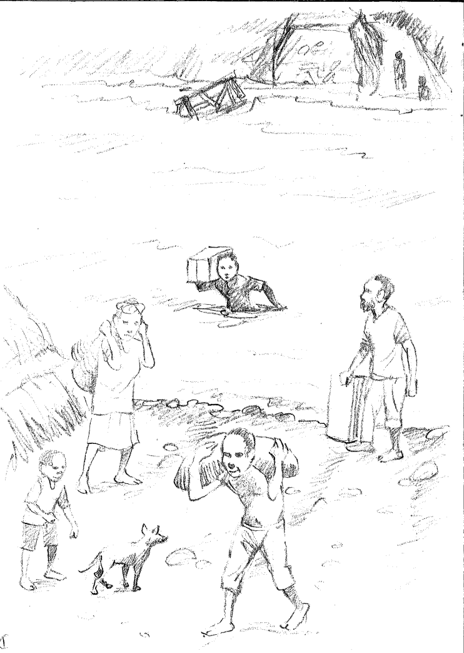
This story is about Alphonse and his followers.
Alphonse’s district had only one road going in and out. The road crossed a big wide river.

Slide 3
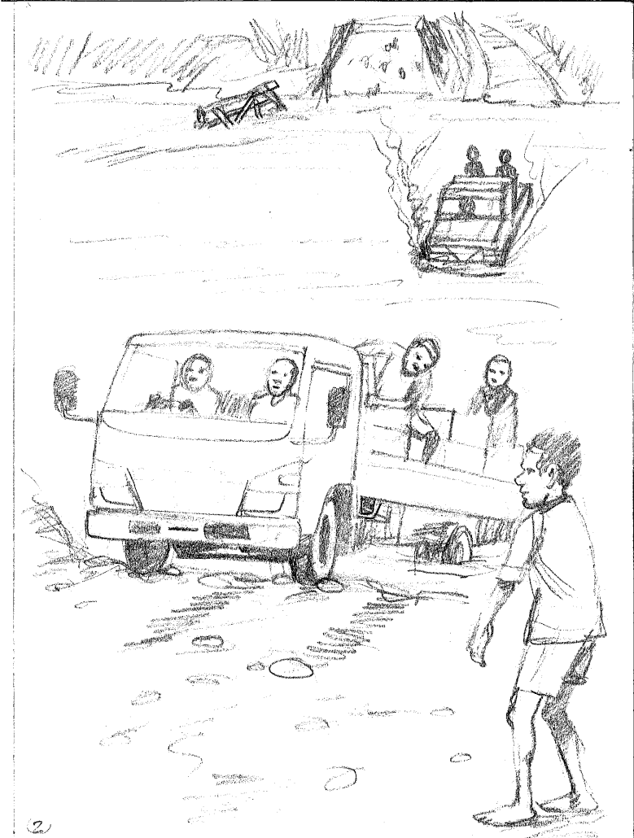
A few years ago the bridge across the river was washed away. Now only trucks could cross when the river was down, which wasn’t very often.

Slide 4
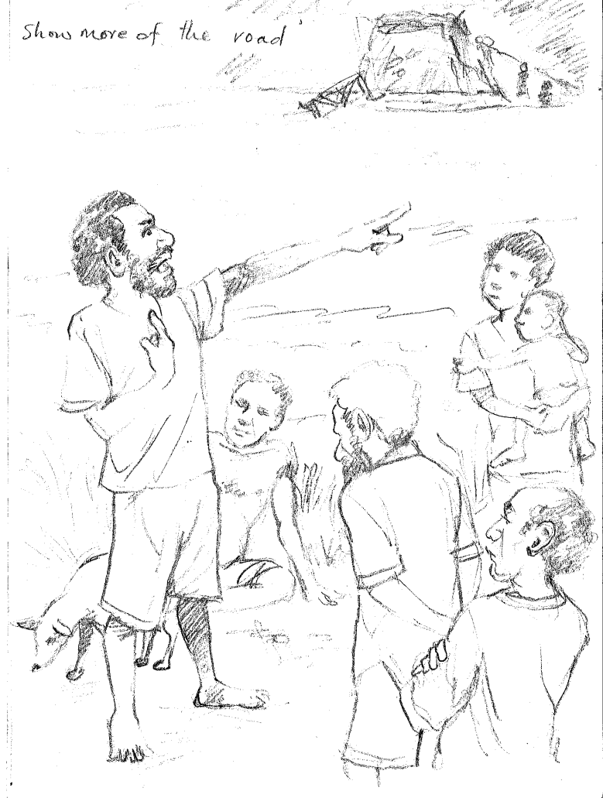
Alphonse had told everyone that if he was chosen as a leader he would get a new bridge built.

Slide 5
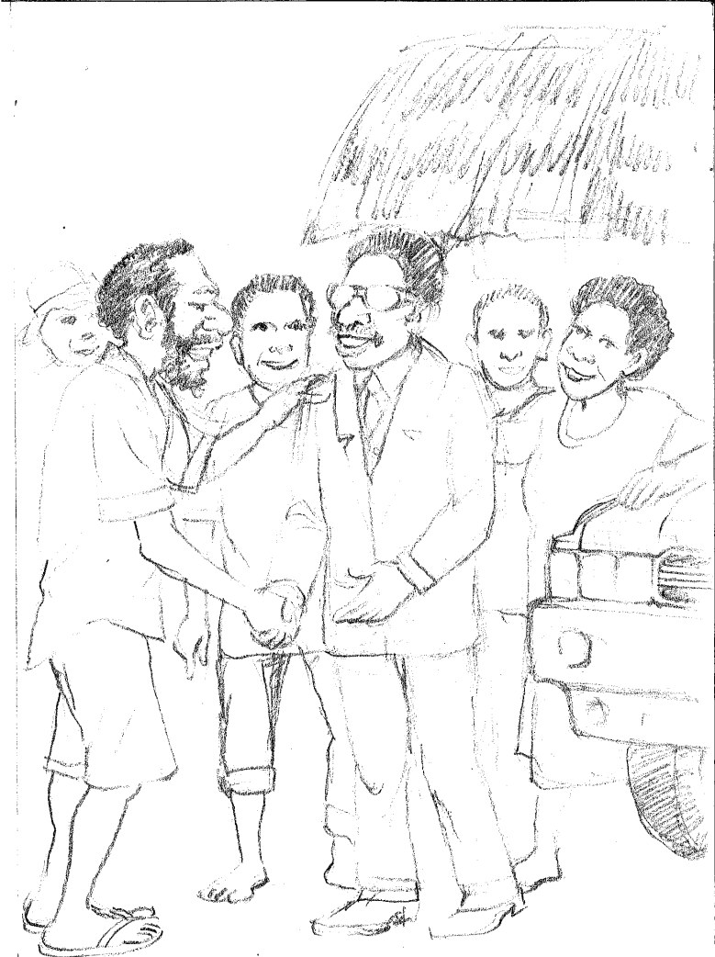
Alphonse was chosen as the member of parliament for his district. He felt very important now.
He was now a proud son of his district and wanted to be seen as a leader. {Ten seater, sun glasses, suit}

Slide 6
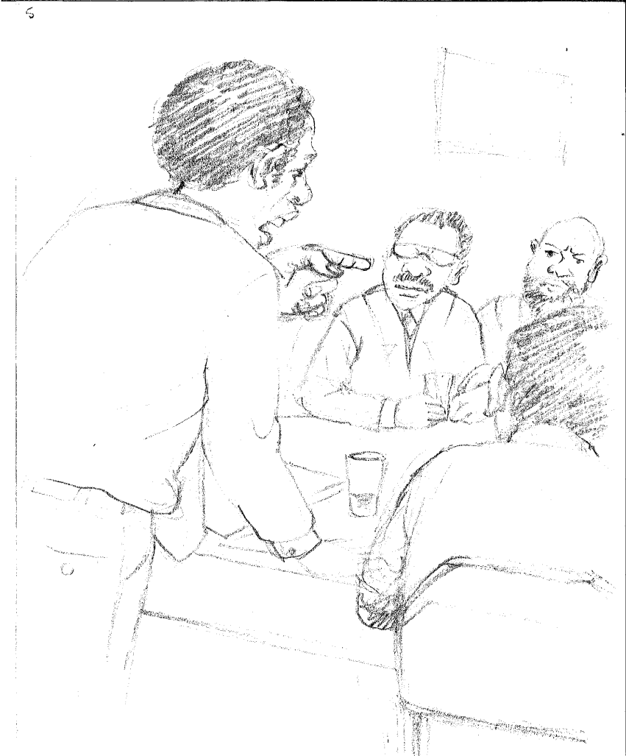
Alphonse went down to see the government. He told them about the problem in his district with the river. They told him he would have to wait one year so it could be part of the budget.

Slide 7
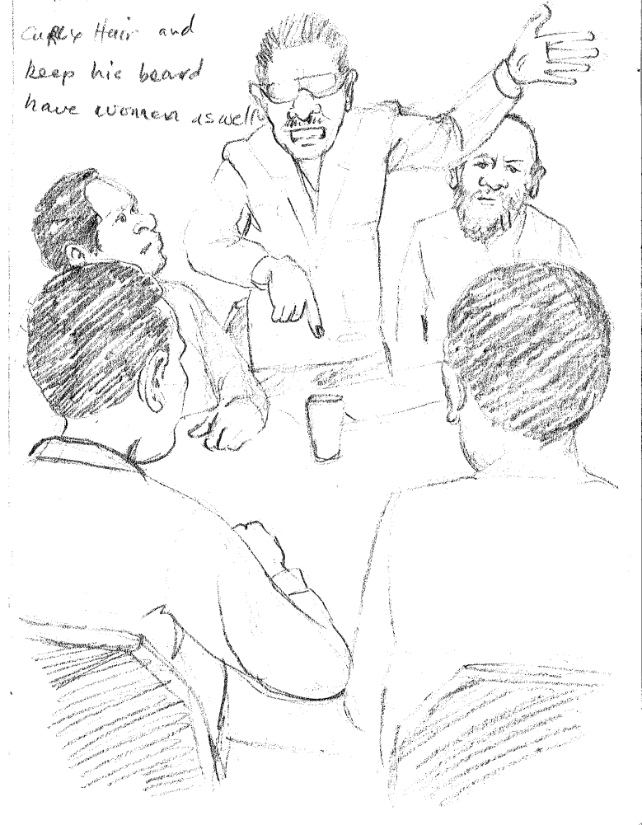
“What!” said Alphonse, “My people need it now!”

Slide 8
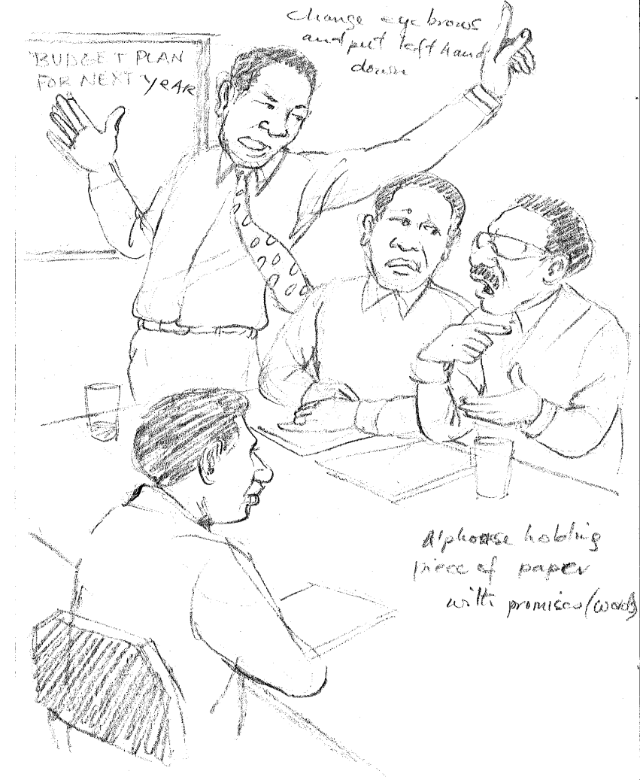
“No”, said the other members. “We have to collect the taxes and then we will put in the budget plan for next year.
“Ok” said Alphonse. “But I have to keep my promises.”

Slide 9
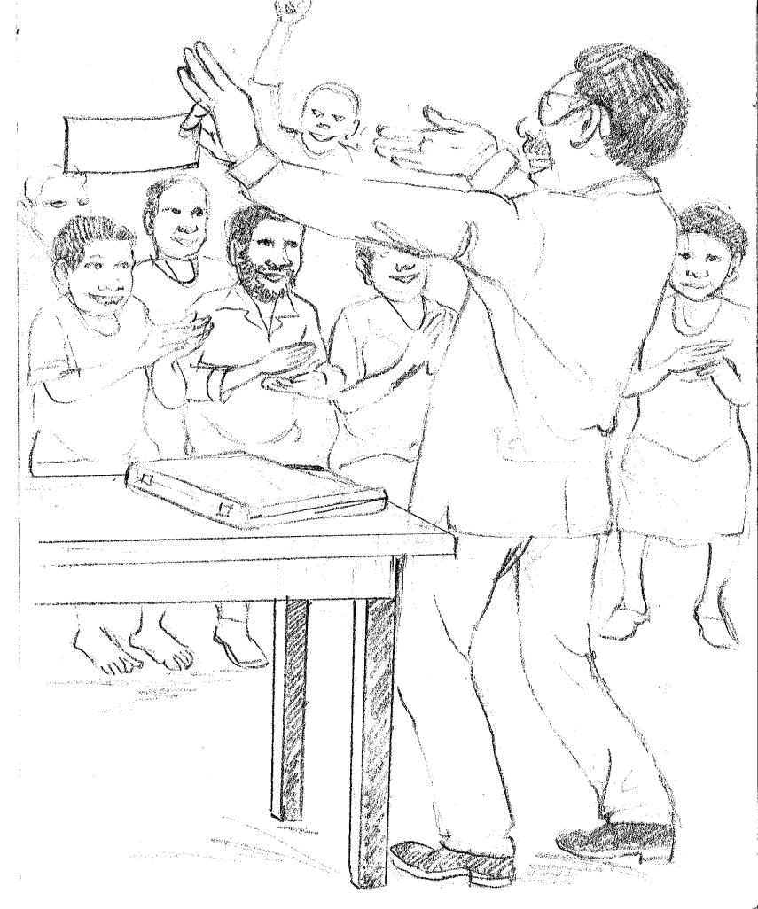
At the end of the next year Alphonse called all the leaders together in the district centre. He announced, “Today, I have a cheque from the government which says 7 million, 2 hundred and 62 thousand, 5 hundred and 32 kina and fifteen toea for the building of the bridge.” He didn’t say anything about where the government got the money from.

Slide 10
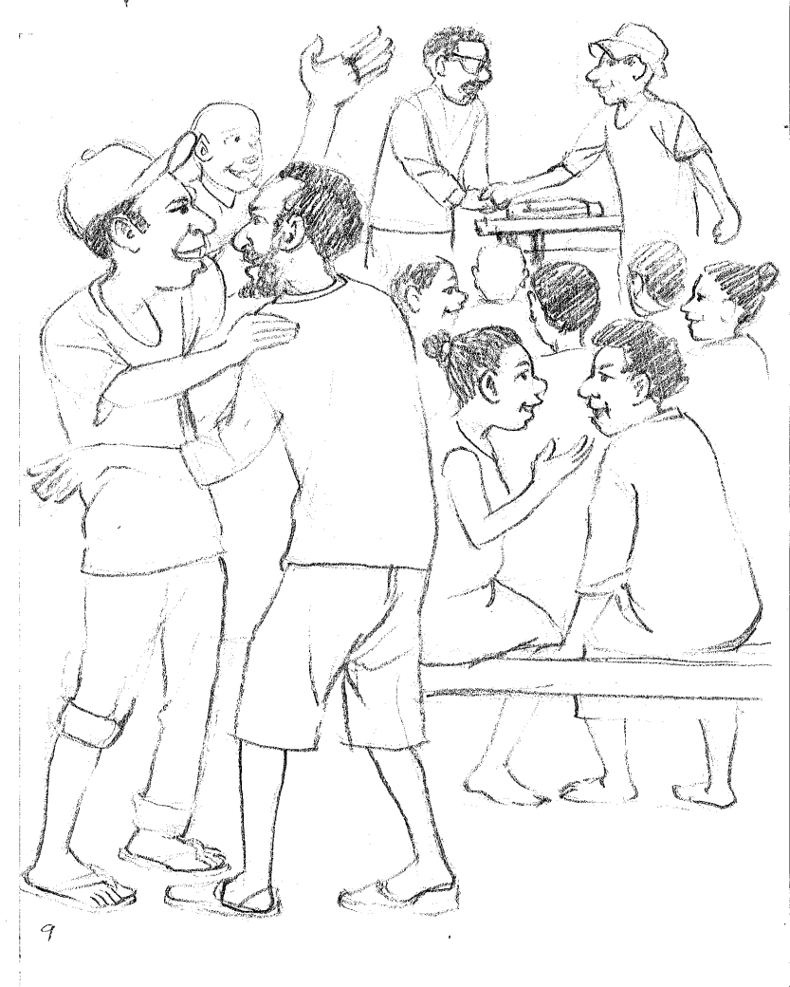
All the people said, “Alphonse has got 7 million, 2 hundred and 62 thousand, 5 hundred and 32 kina and fifteen toea from the government!”

Slide 11
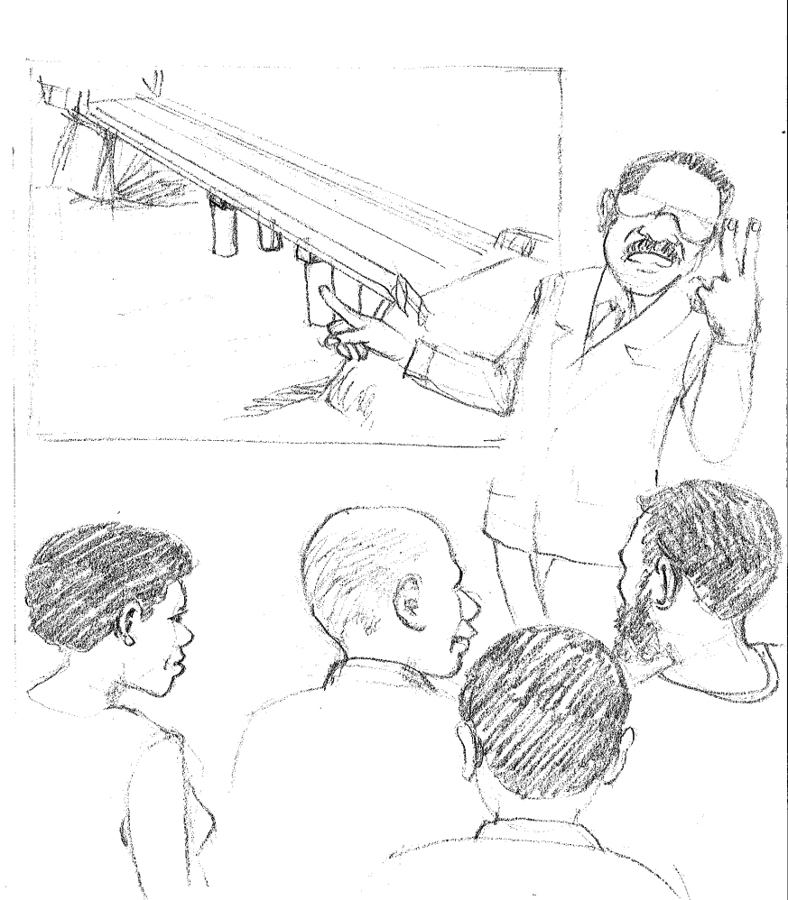
Alphonse then showed them a plan of the new bridge. He said, “Look the new bridge has got four pillars holding the bridge up! And it has two lanes!

Slide 12
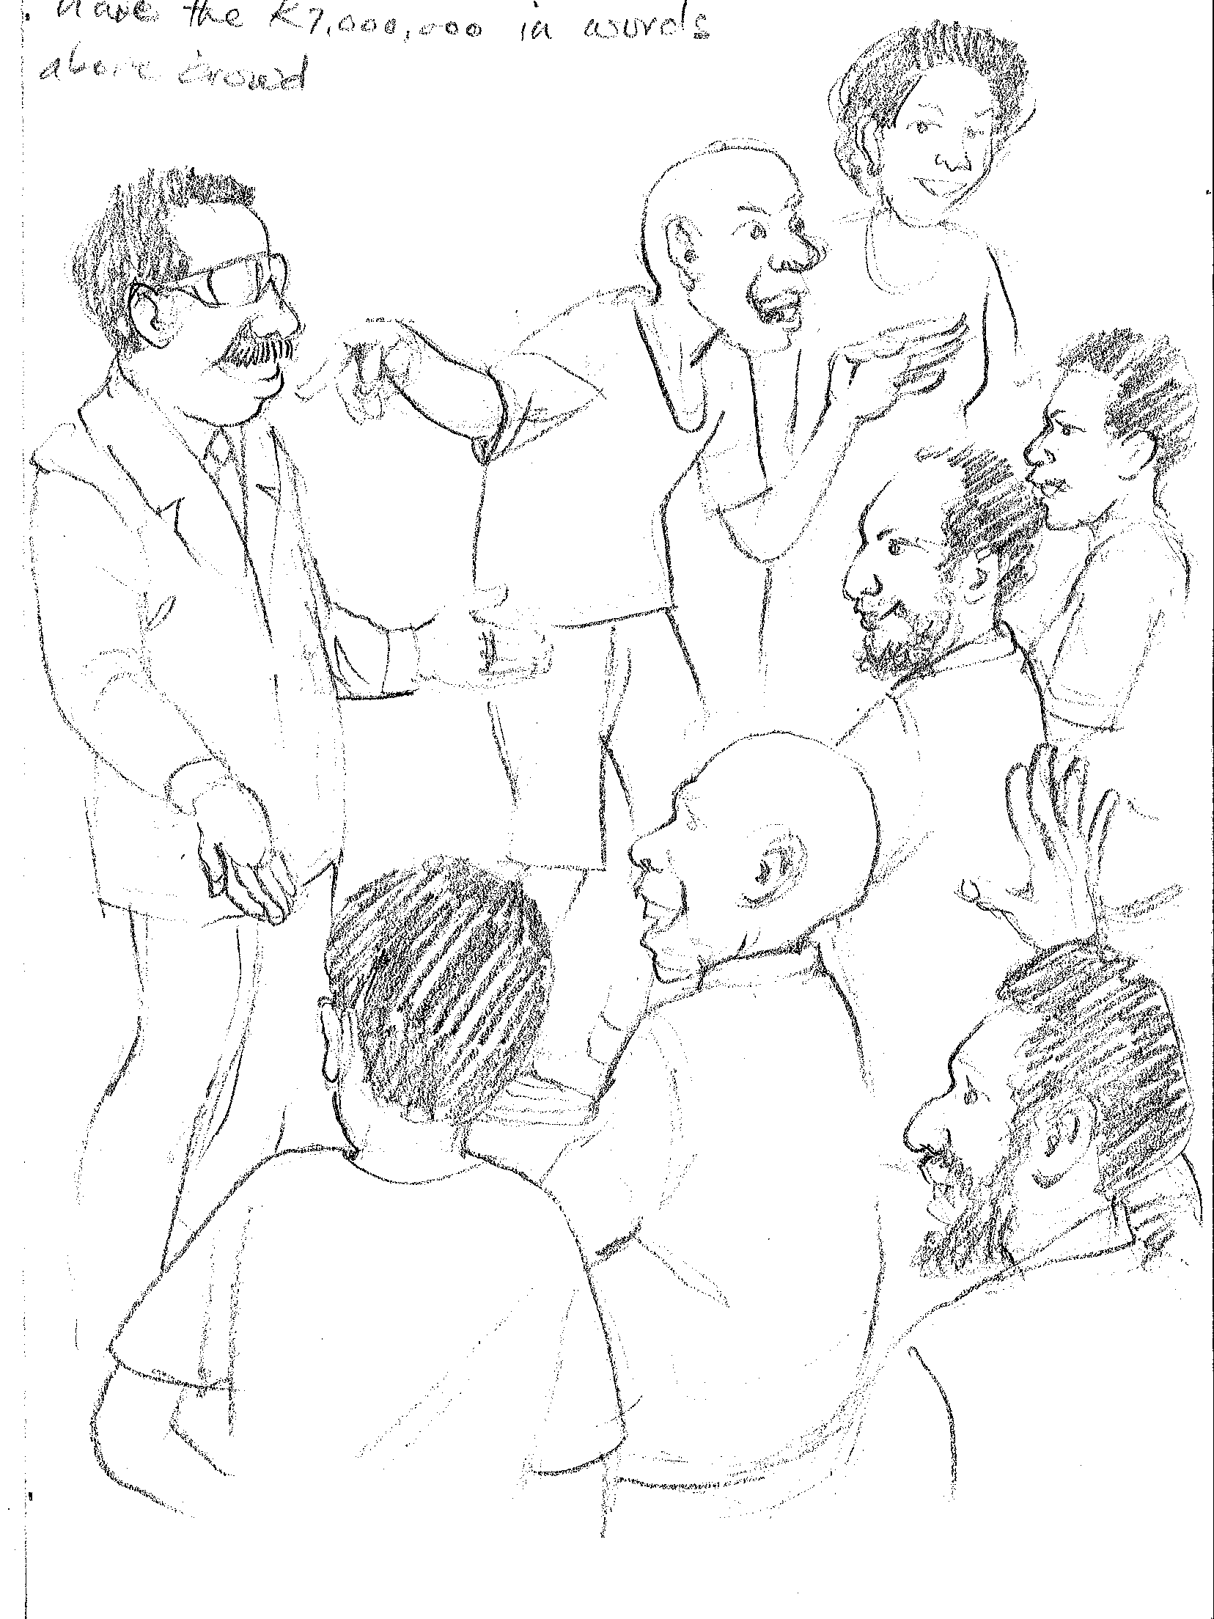
“Yeah”, said all the people. “Alphonse has got 7 million, 2 hundred and 62 thousand, 5 hundred and 32 kina and fifteen toea from the government!”

Slide 13
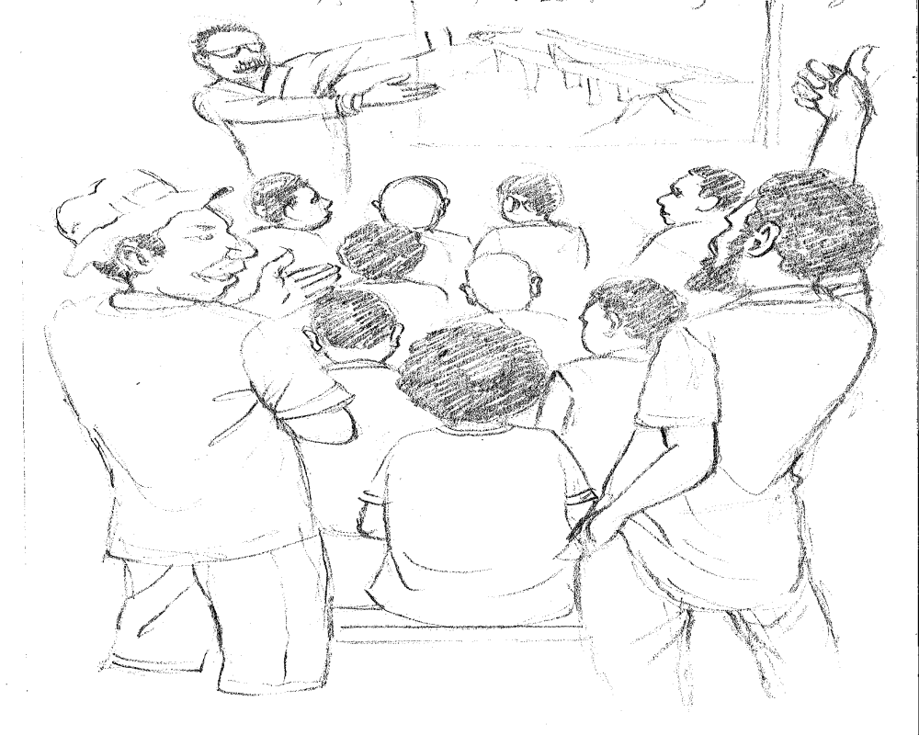
Alphonse was happy so he also said while pointing, “It has foot paths on either side.” “Yeah”, said all the people. “Alphonse has got 7 million, 2 hundred and 62 thousand, 5 hundred and 32 kina and fifteen toea from the government!”

Slide 14
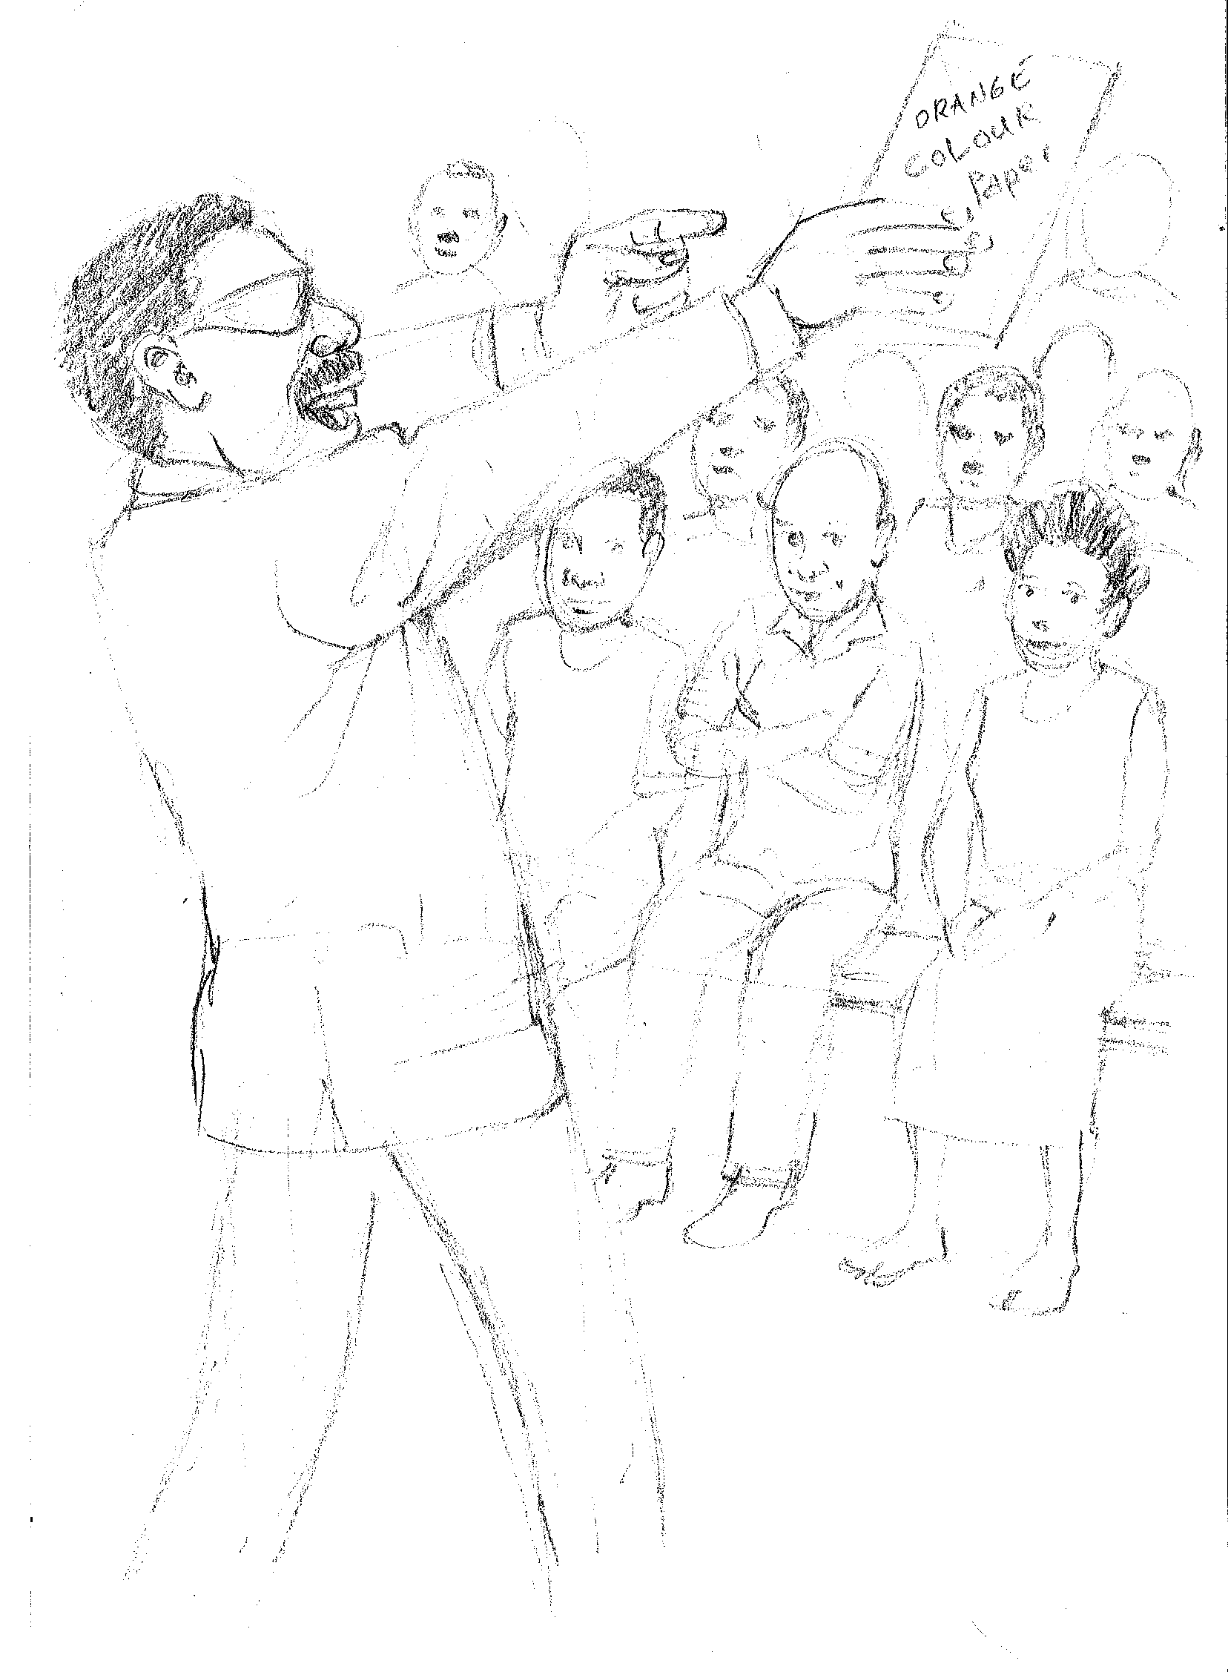
Alphonse added, “It’s going to be painted orange as that is our favourite colour!”
“Yeah”, said all the people. “Alphonse has got 7 million, 2 hundred and 62 thousand, 5 hundred and 32 kina and fifteen toea from the government!”

Slide 15
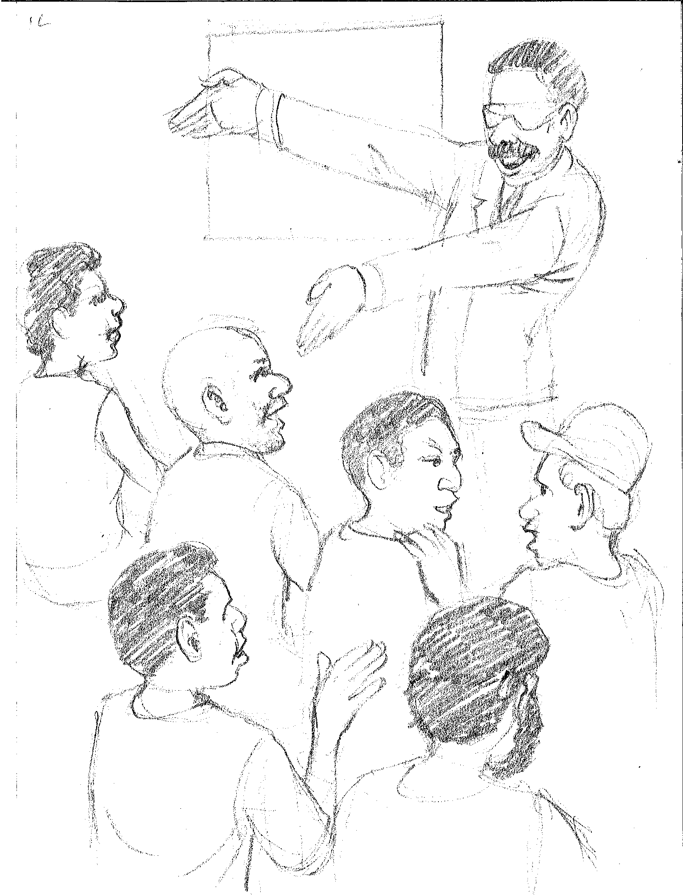
Finally he said with a big smile, “We are going to seal the road for one kilometre either side!”
“Yeah”, said all the people. “Alphonse has got 7 million, 2 hundred and 62 thousand, 5 hundred and 32 kina and fifteen toea from the government!”

Slide 16
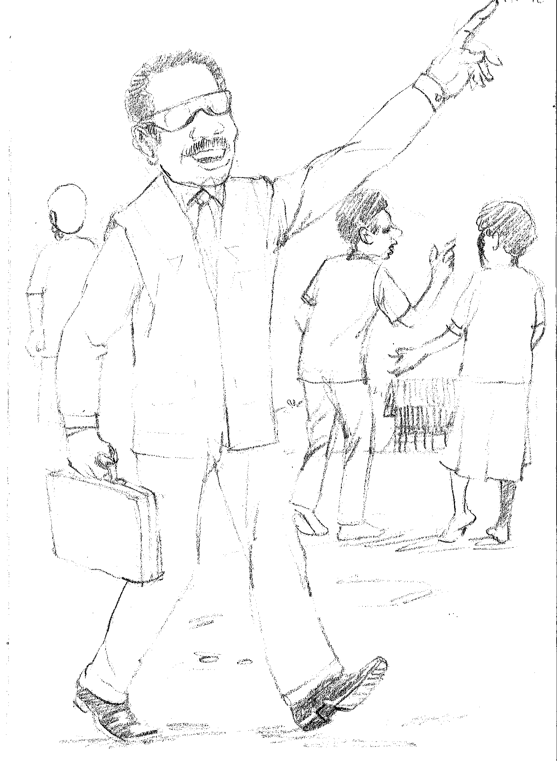
The meeting closed and all the people went home. Alphonse was very happy. He was so proud and felt he was going up in the world.

Slide 17
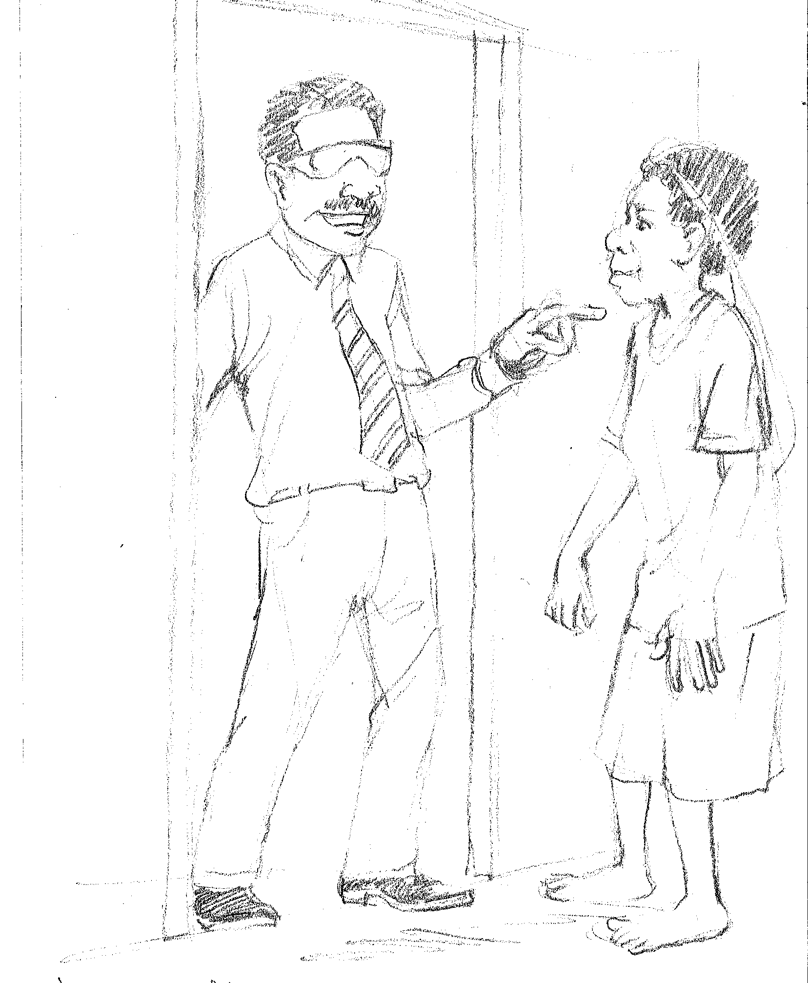
The next day there was a knock on his door. A woman stood outside. “Yes”, said Alphonse. “How can I help you?”

Slide 18
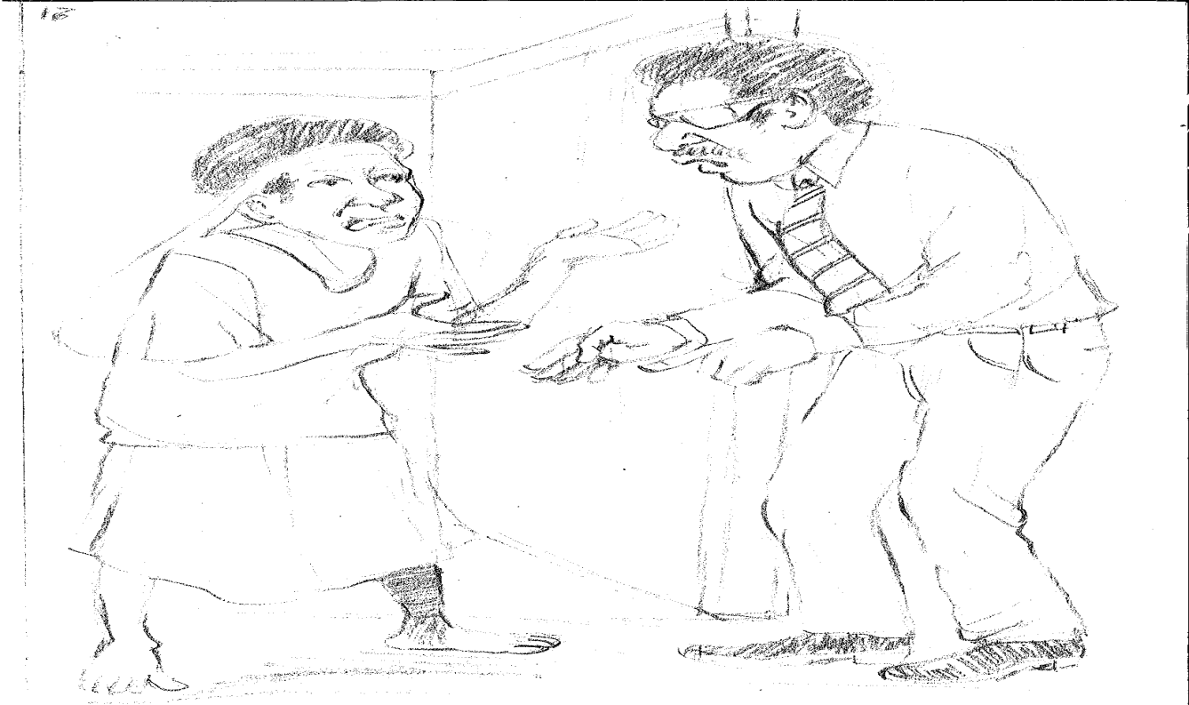
The woman said, “You remember me? I used to bring you food when you were at school. I’m your wantok.”
“Oh, yes Auntie Grace I remember now.” Alphonse answered. “How can I help you?” “Oh, I have to pay for some fees for my son to go to university. Can you help me?” Auntie said. Alphonse did not have a lot of money of his own but he had some so he agree to help.

Slide 19
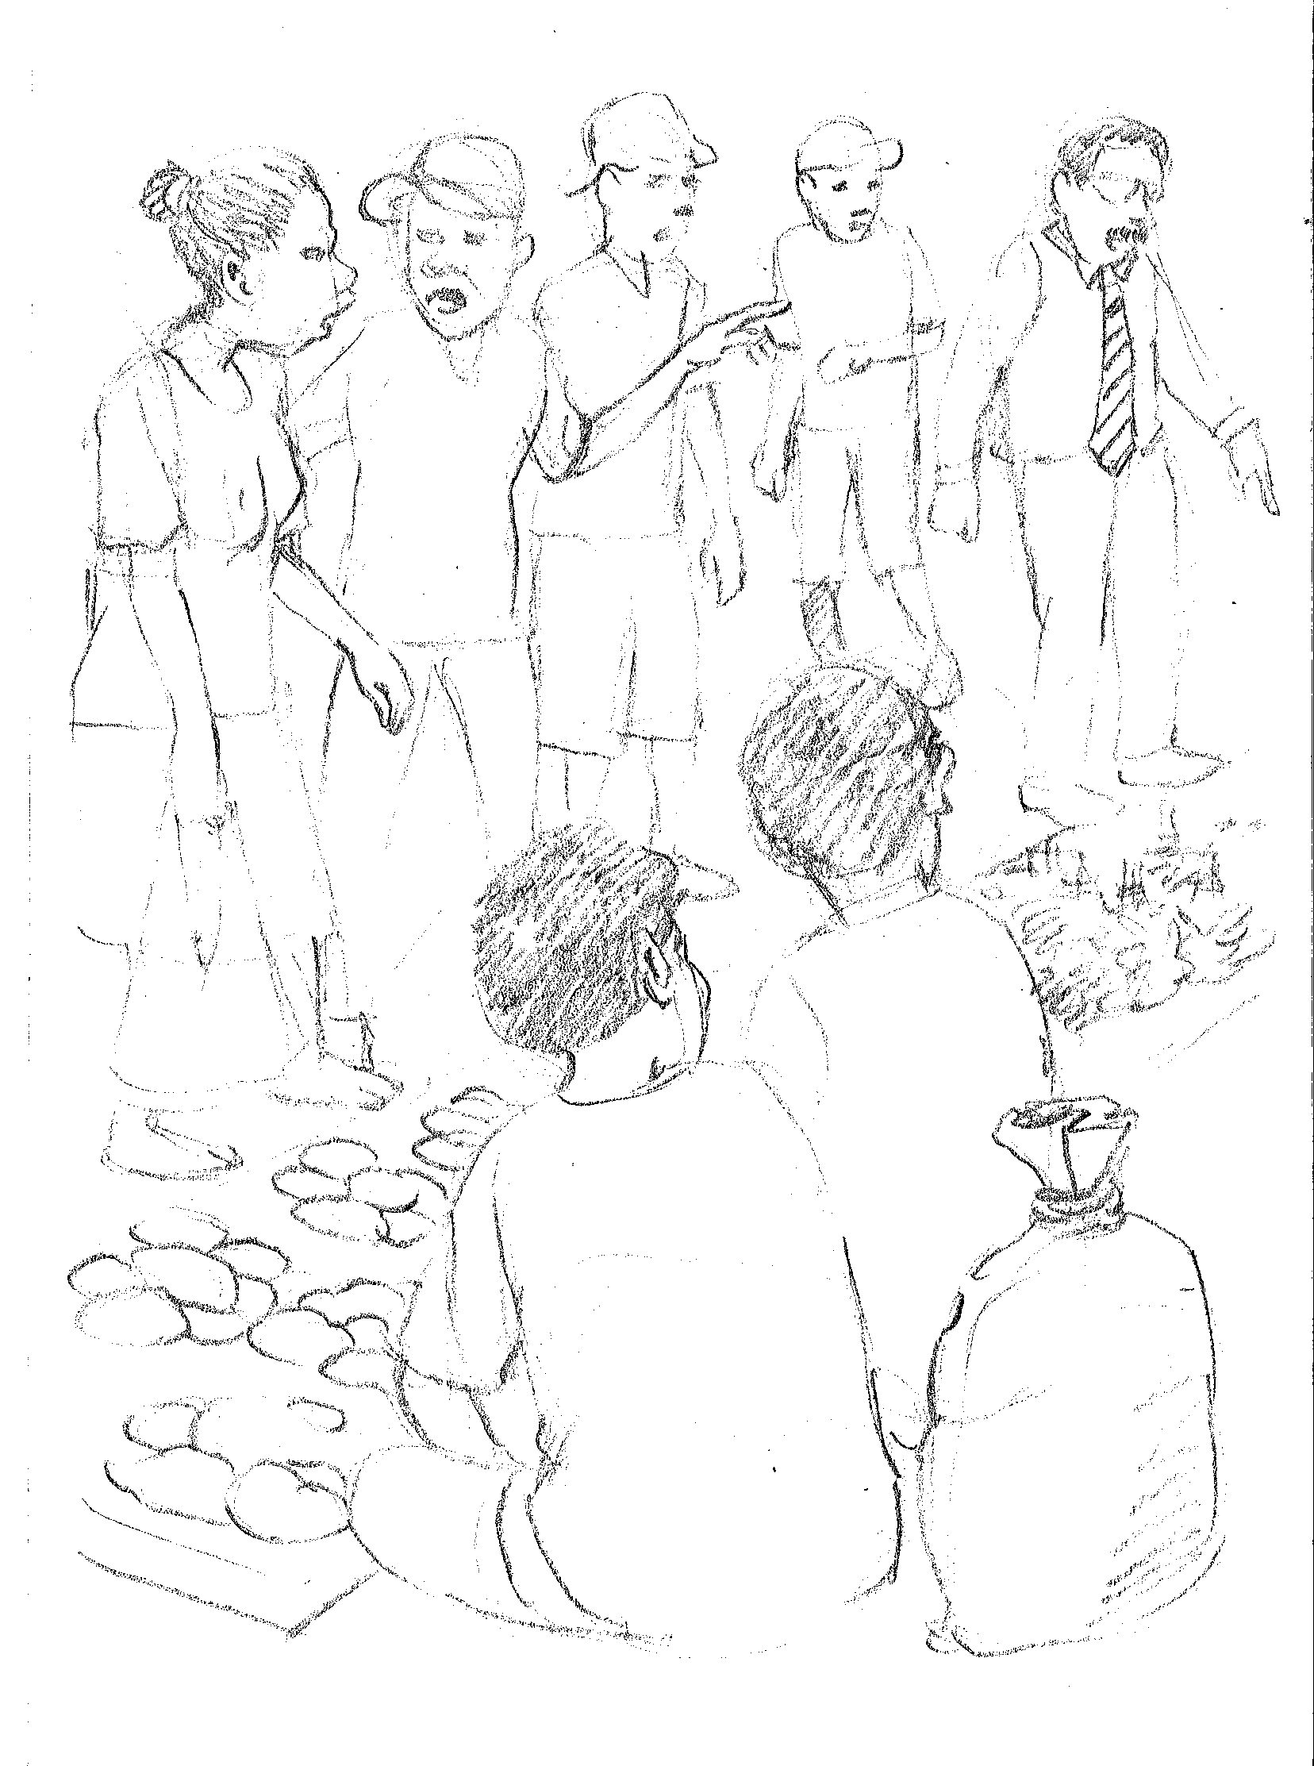
In the market in the district town people said to each other, “Alphonse is so good he has got 7 million, 2 hundred and 62 thousand, 5 hundred and 32 kina and fifteen toea.”

Slide 20
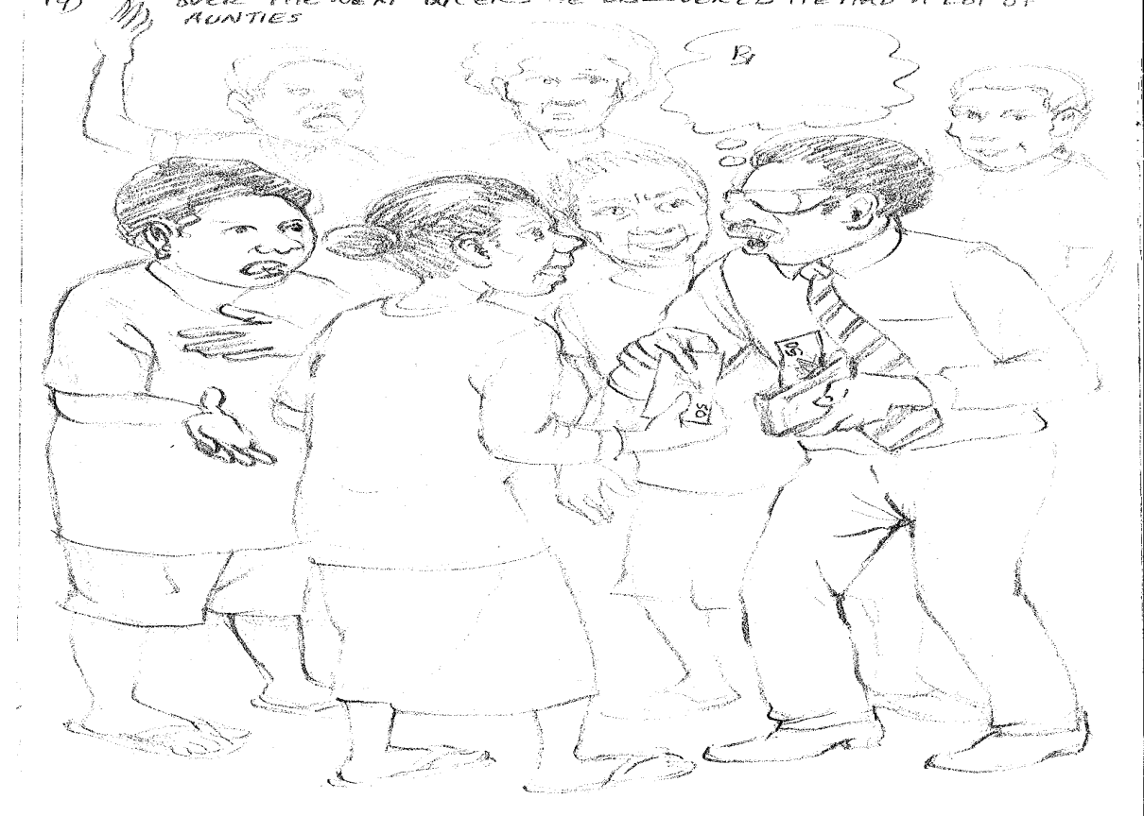
Over the next weeks he discovered he had a lot more aunties who had relatives that needed help. Alphonse’s money was soon gone. But he decided that the bridge didn’t really need foot path on both sides so he would use some of the bridge building money. Alphonse felt like a really important person now. He was helping so many people.

Slide 21
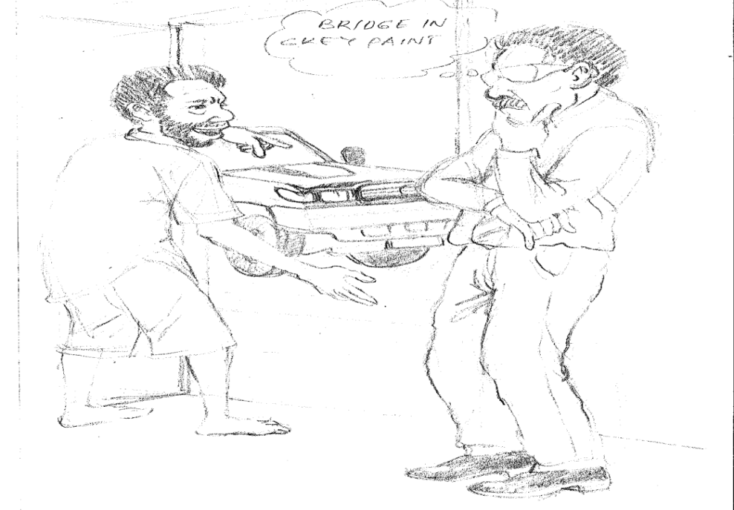
Then another knock came on his door. It was a man named Ivan this time. He said, “Nephew you look so busy. Can you give me a job as a driver?” Alphonse didn’t need a driver really but he did need someone to answer the door so he agreed. He decided that if he paid Ivan to answer the door he could get the bridge built faster. But what to pay him with?
Then Alphonse thought…. The bridge would be just as good painted grey and grey paint was cheaper.

Slide 22
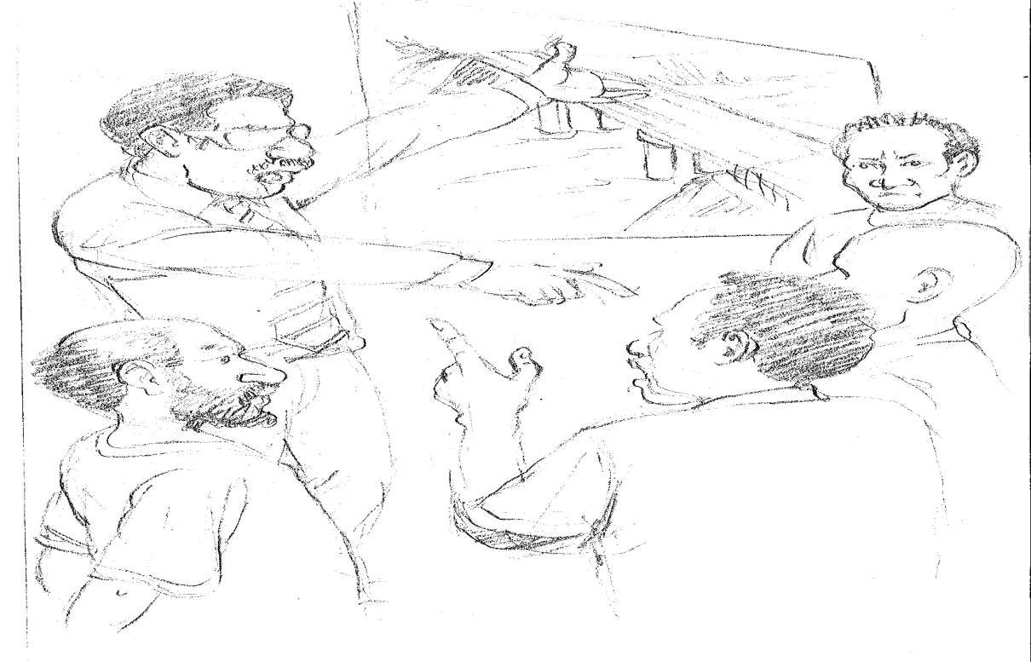
Over the next weeks he discovered he had a lot more uncles who could help him build the bridge faster. Alphonse decided that the bridge didn’t really need to tar seal either side so he would pay for the peoples fortnightly pay with that money. It would also help pay for the funerals he was helping people pay for.

Slide 23
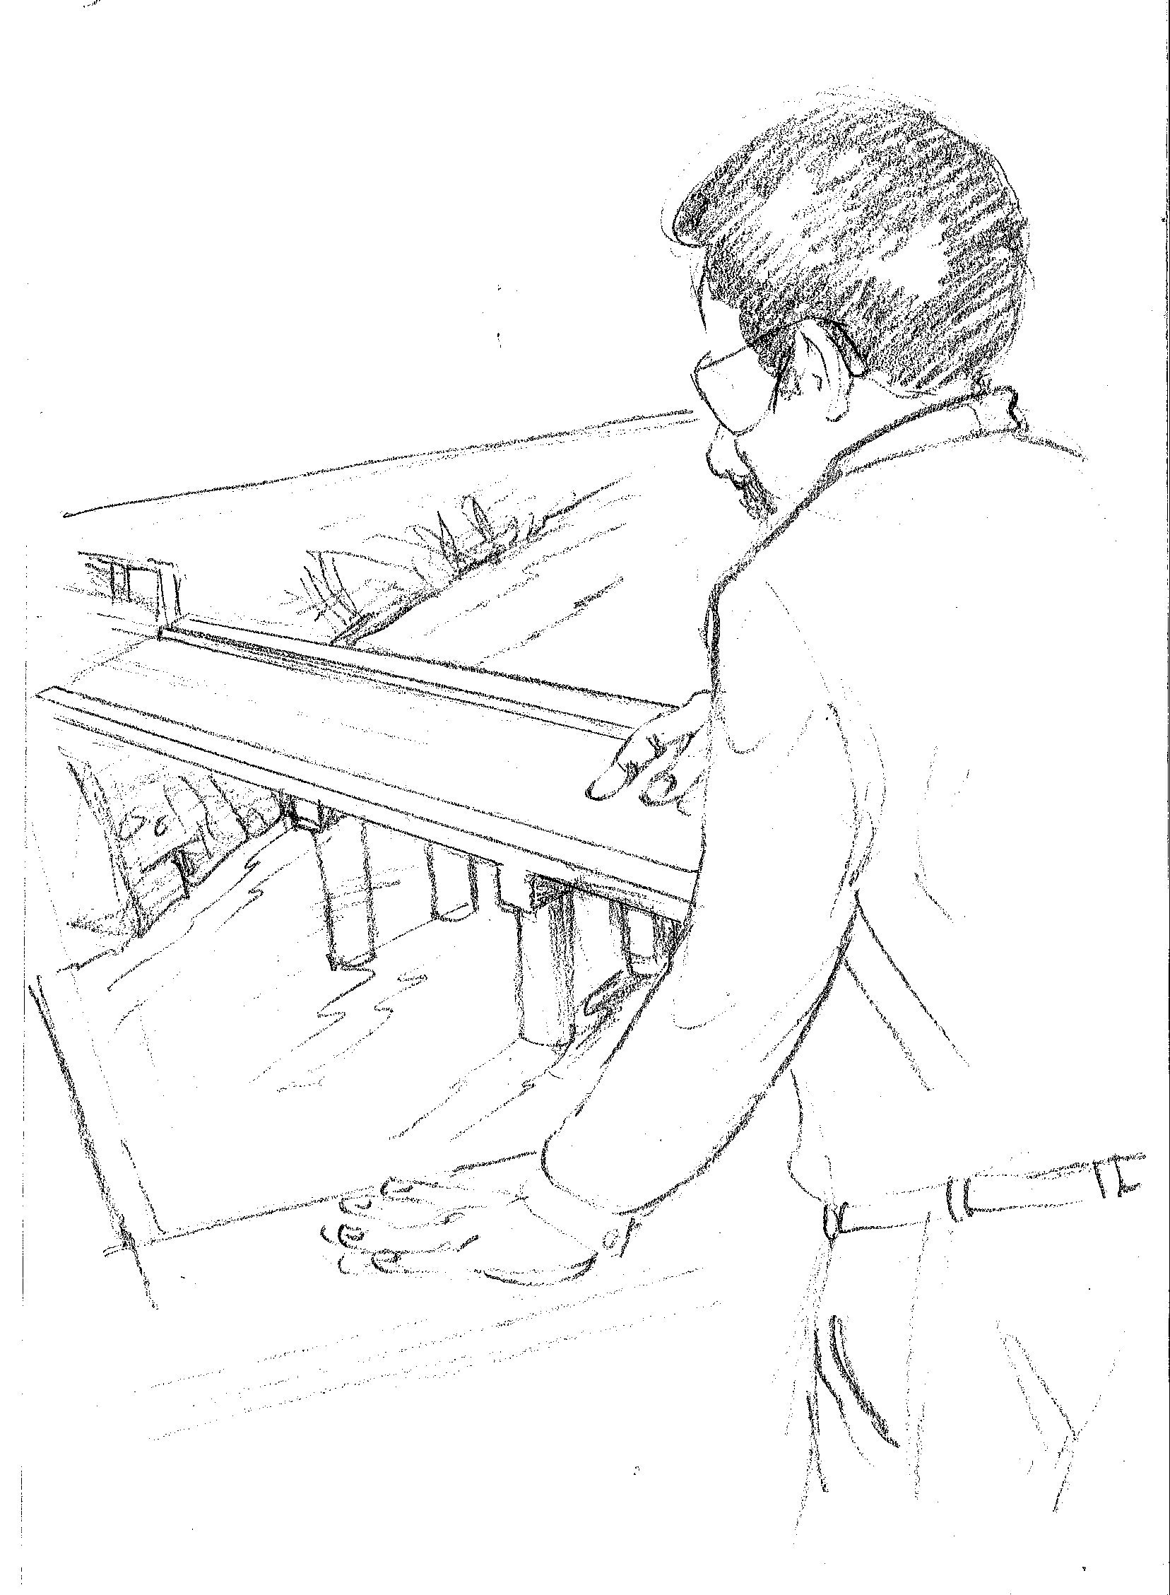
To pay for all of that Alphonse looked at the plan and decided that the bridge didn’t need to have so many pillars so he cut the number from four to two.

Slide 24
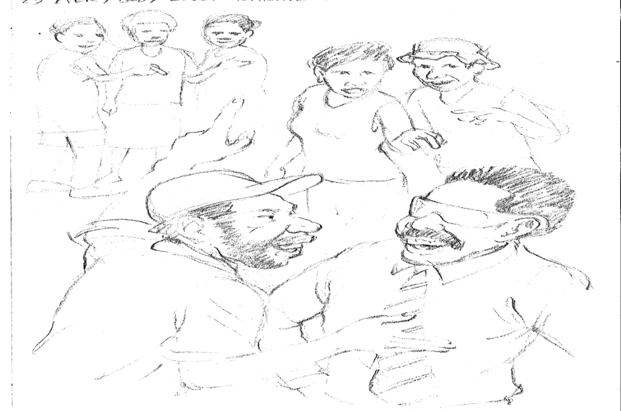
Everybody loved Alphonse now. They met in the market and in church and they said, “Alphonse is so good he has got 7 million, 2 hundred and 62 thousand, 5 hundred and 32 kina and fifteen toea for us!” Alphonse felt very, very important. He felt so important that when one of the community leaders said, “Alphonse you are too important to go by car you need a helicopter so you can quickly come and go from the government to get money.”

Slide 25
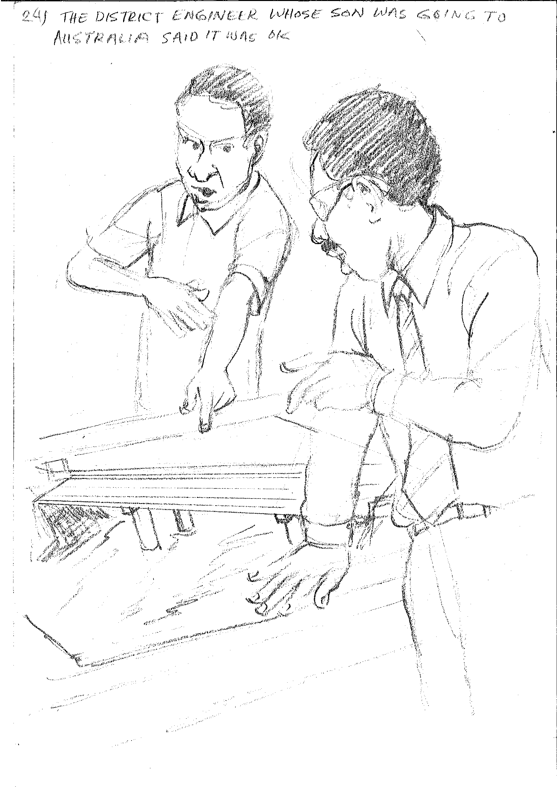
He thought about it. “Yes I am important. I pay school fees, I provide jobs. I pay for funerals and I am building a bridge.” So he agreed. To pay for it he looked at the plans again and decided that it would be ok if he took out one more pillar holding up the bridge. The district engineer whose son was going to high school in Australia said it was ok!

Slide 26
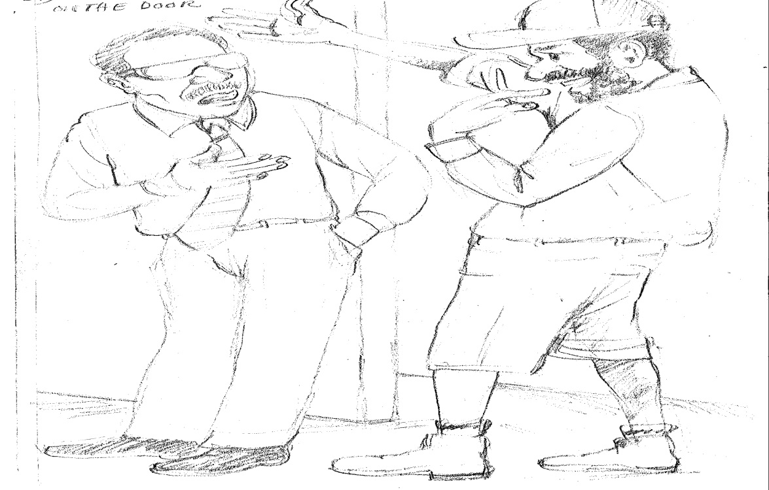
A few days later his cousin brother Max knocked on the door. “Hi Max”, said Alphonse. “How can I help you? I am really busy deciding who will get the job to build the bridge.”
“Oh cusi-bro I can help you with that.” said Max. Alphonse was a bit surprised.

Slide 27
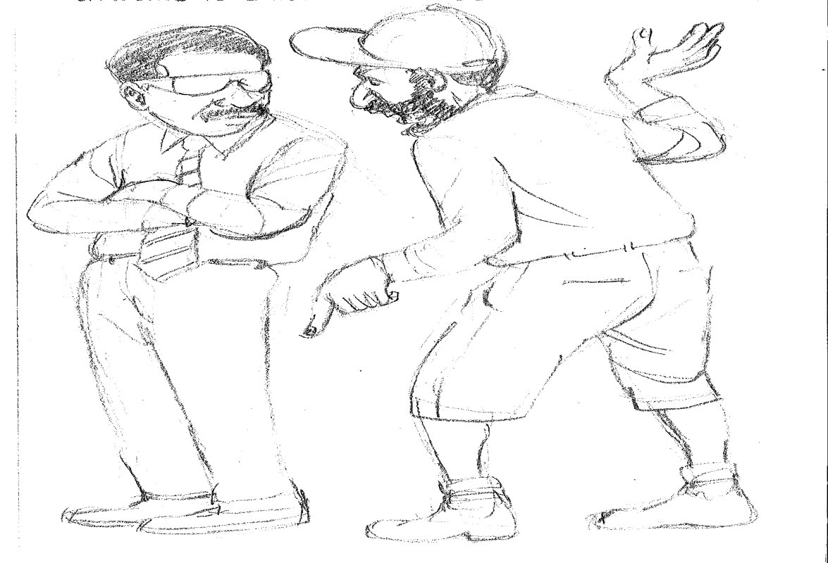
“Yes, I was one of the businesses that sent you a letter offering to build the bridge.” said Max. Max went on… “If you choose our company then all the money would stay in our district. It would be a good way you help us all.”

Slide 28
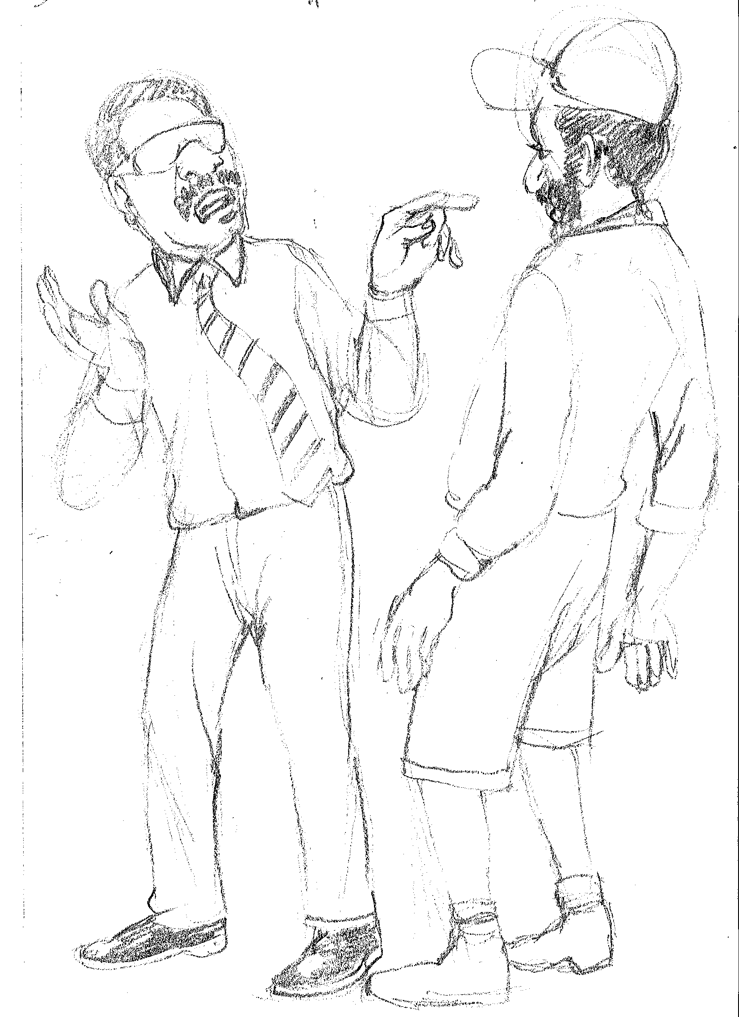
Alphonse then said, “but Max you don’t have any equipment except a wheelbarrow and the only thing you ever built was a hauswin. ”

Slide 29
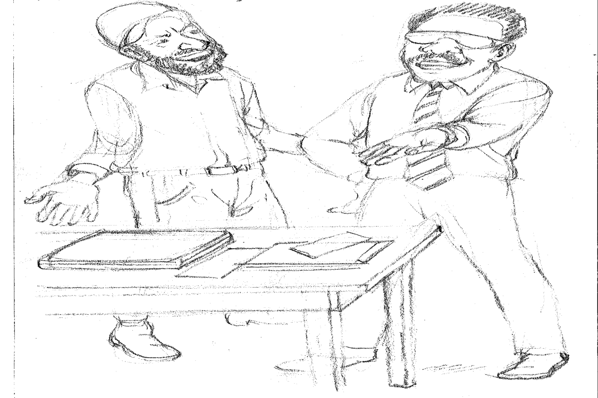
Max replied, “Yeees, but just imagine if we got the job we could buy lots of equipment and get some outsiders to help. At the end our district would have a construction company.” Alphonse started feeling even more important. “Ok let’s look at the letters from the other companies.”

Slide 30
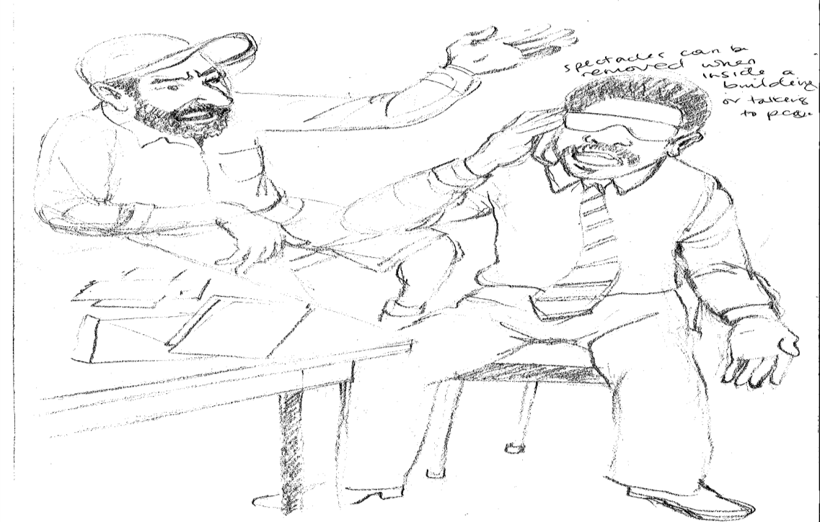
Max and Alphonse did this and they found that Max had the highest price of all the businesses wanting to build the bridge.
Max said, “Look if we do this… we can really help the people. May be we don’t really need that pillar in the middle if we just make it a one lane bridge.” Alphonse called the engineer. The engineer said, “I think so.” Alphonse was convinced.

Slide 31
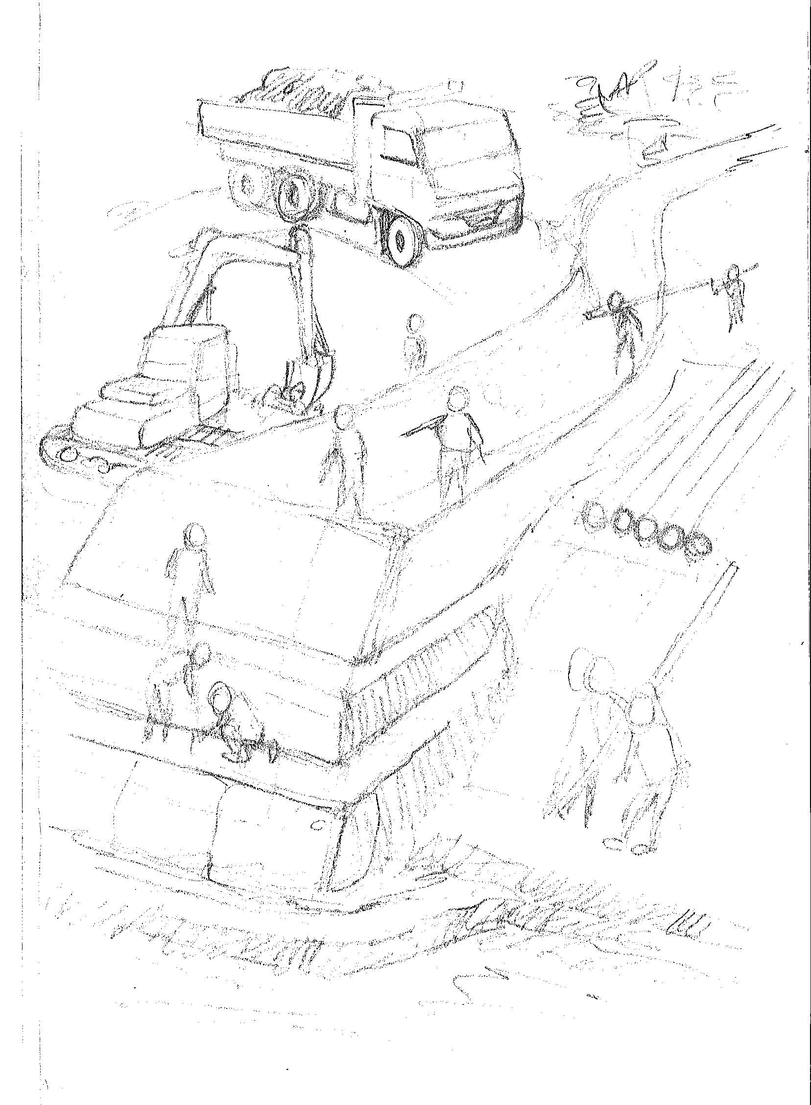
The construction started. The people were happy. They had jobs, didn’t have to worry about fees and funerals and best of all Alphonse had promise a big feast on the day the bridge opened.

Slide 32
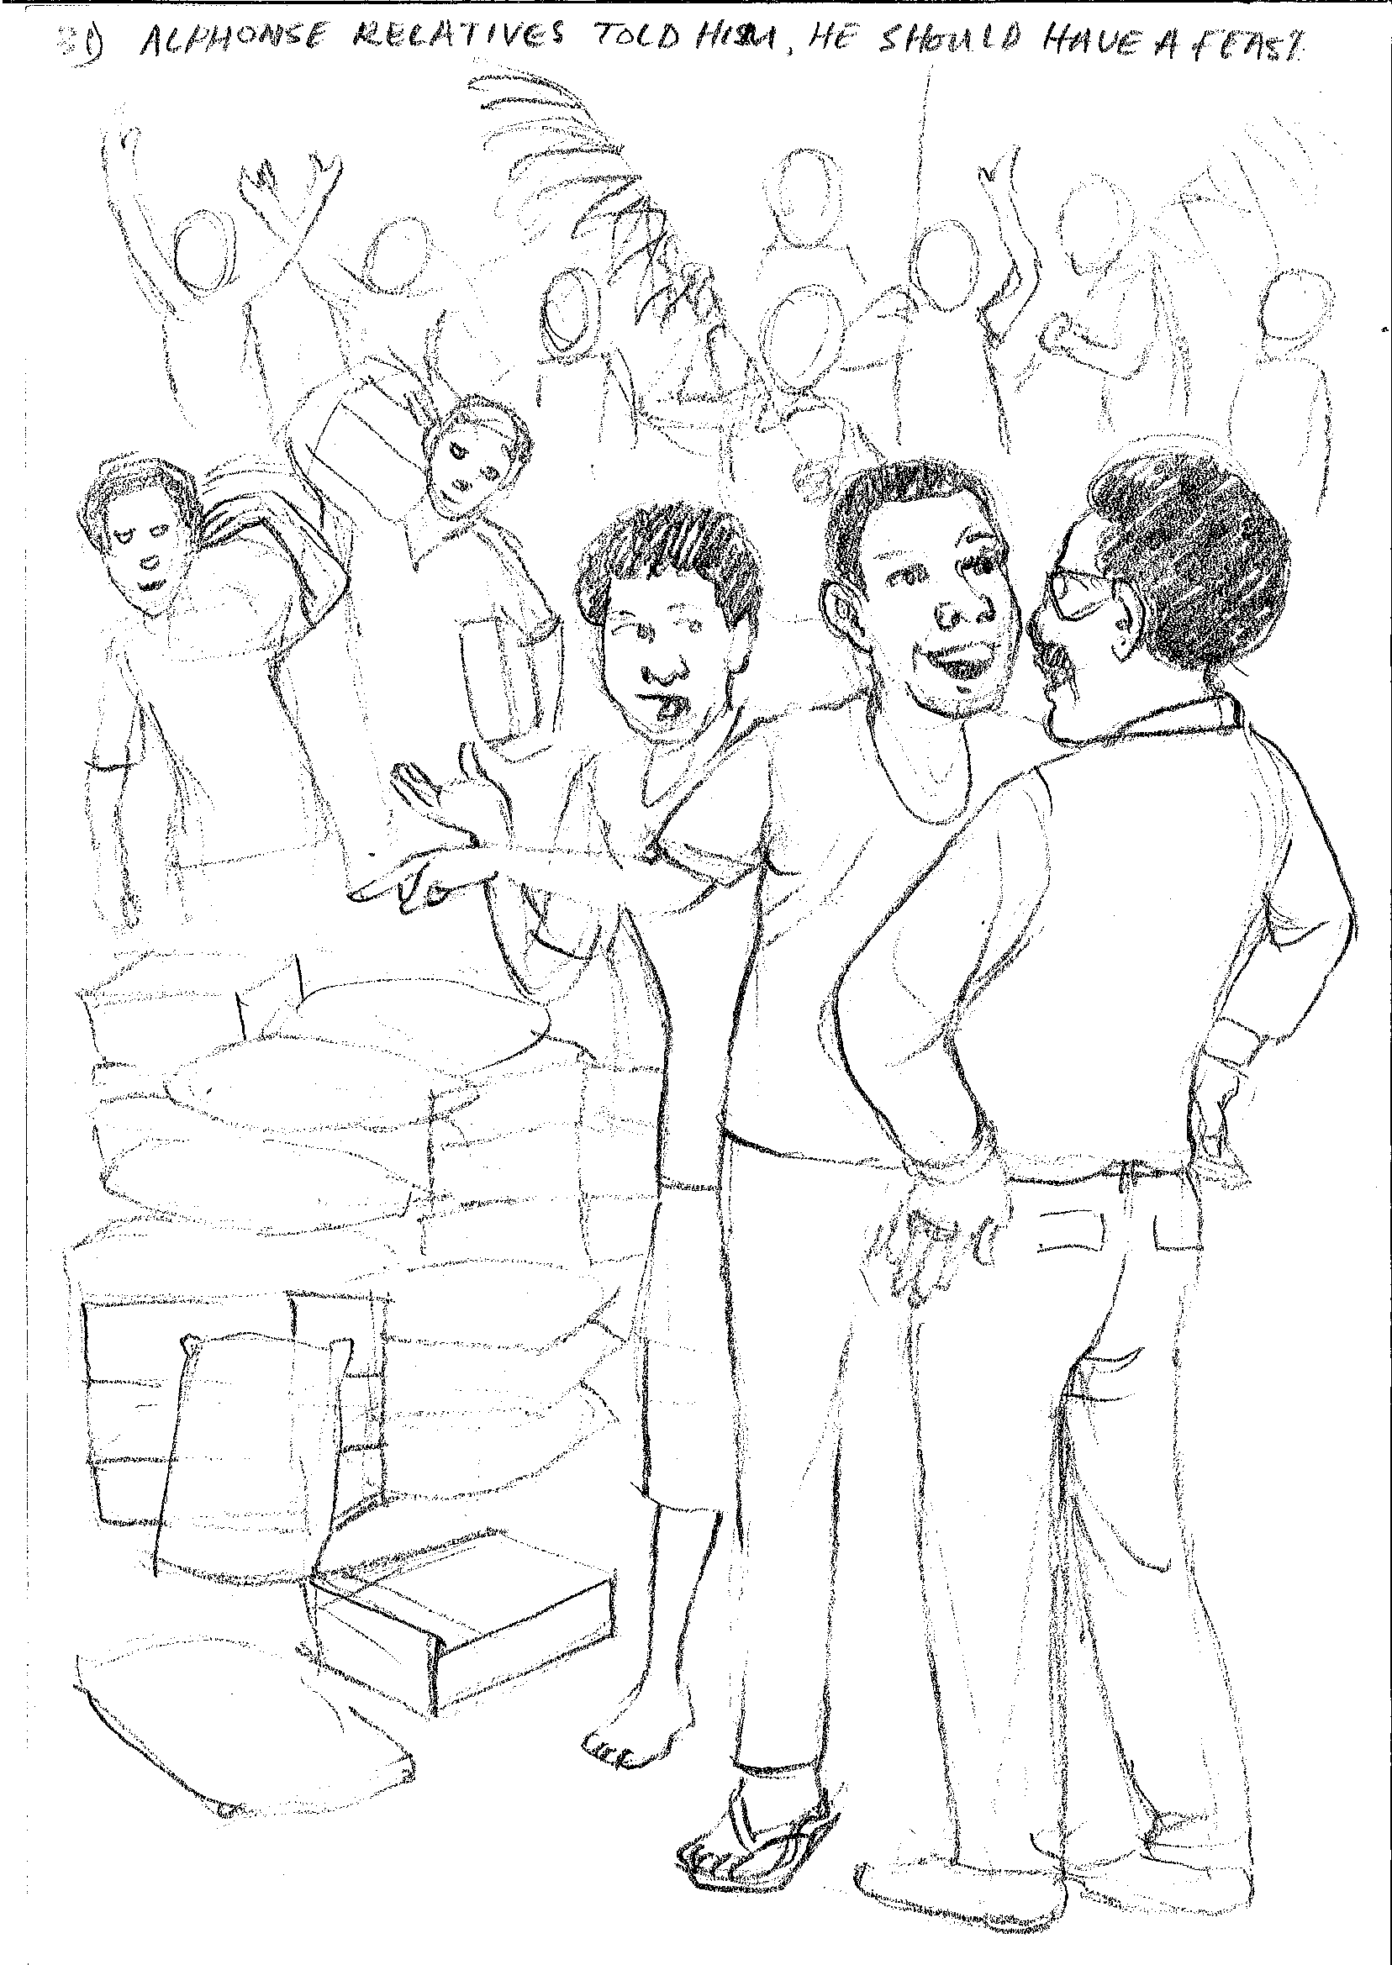
Alphonse’s relatives told him he should have a feast as then he could start his next election campaign. The people were happy because of the free food.

Slide 33
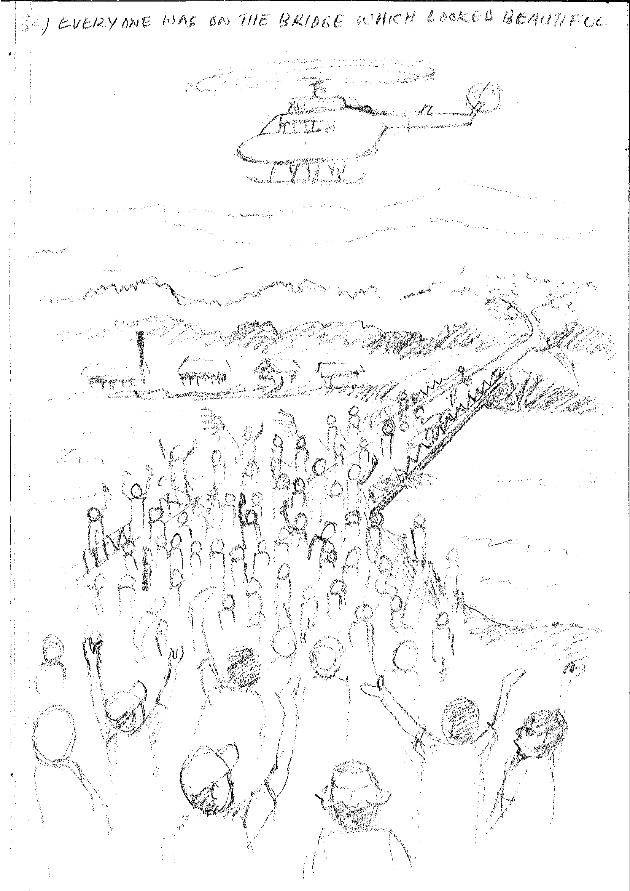
Everyone was on the bridge which looked beautiful as it had been decorated. Max’s helicopter arrived full of lamb flaps. Everyone was shouting, “Alphonse” Alphonse! Alphonse!”

Slide 34
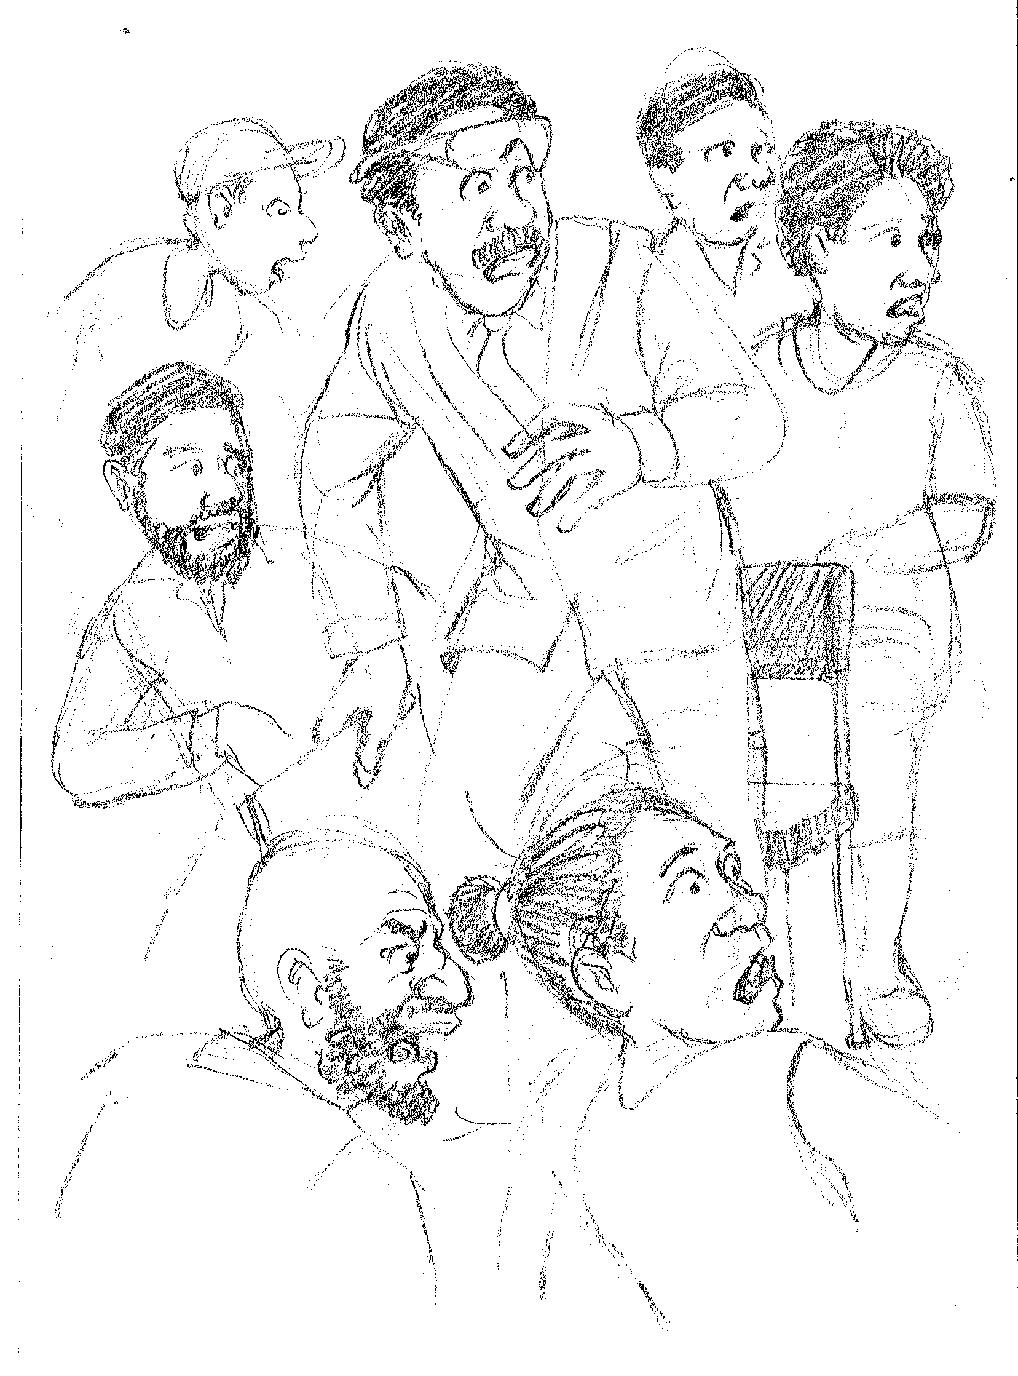
Alphonse got up to speak. Just as he was starting there was a creak and a crack and a groan.

Slide 35
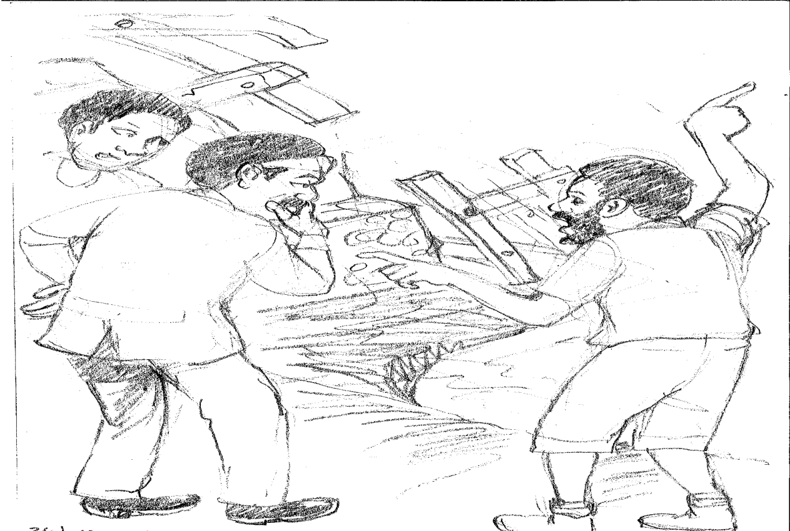
Slowly, the bridge sank and broke into the river.
No one was hurt and they said. Alphonse can you get some more money from the government?

Slide 36
School based civic education
Big book illustrations
THE CLASSROOM

Slide 37
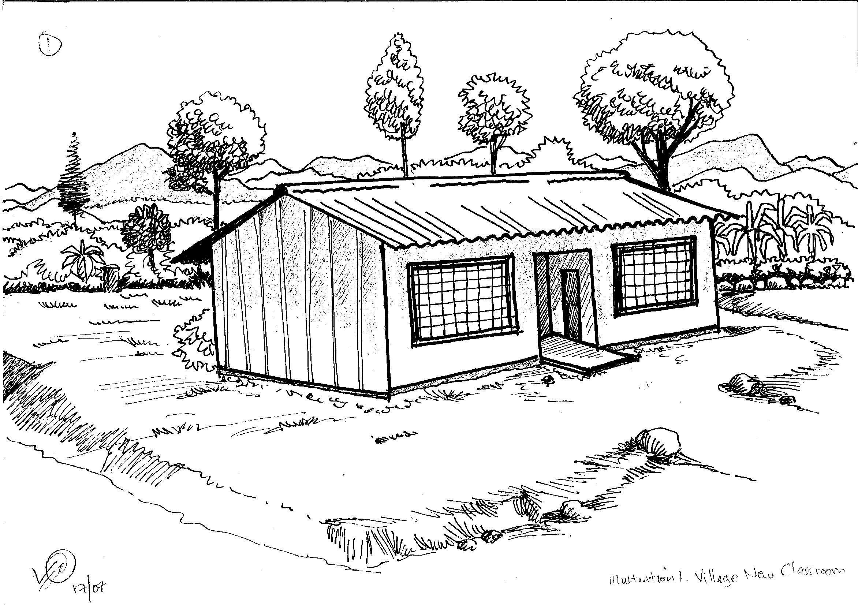
A few years ago in my village there was a lot of stories going around because of the building of a new classroom. The stories were about what people always argue about…. Who has the money and how was it spent.

Slide 38
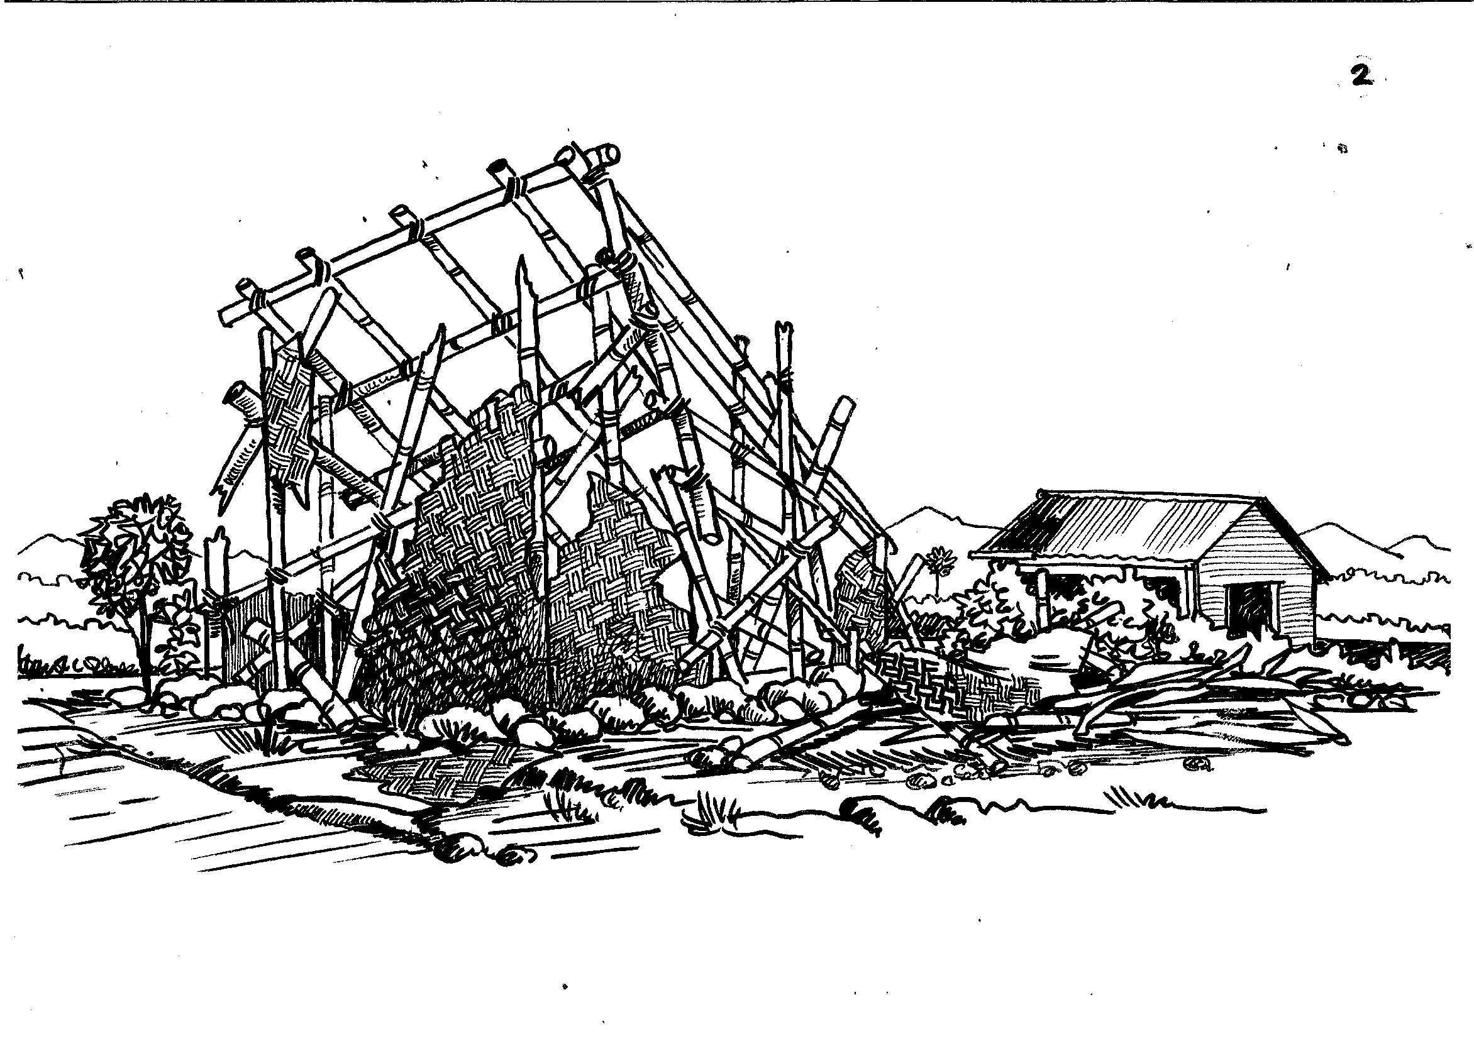
The whole thing started when there was a storm which completely wrecked the grade 5 classroom at our primary school. Some of the other classrooms were damaged but not as badly as this one.

Slide 39
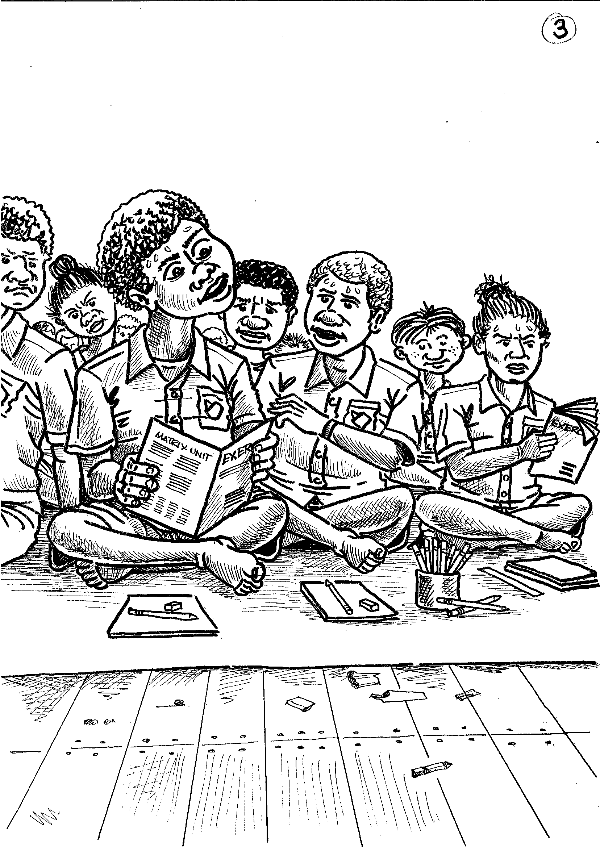
At first all the grade 4 and grade 5 students were squashed into one room. Sometimes it got hot and smelly.

Slide 40
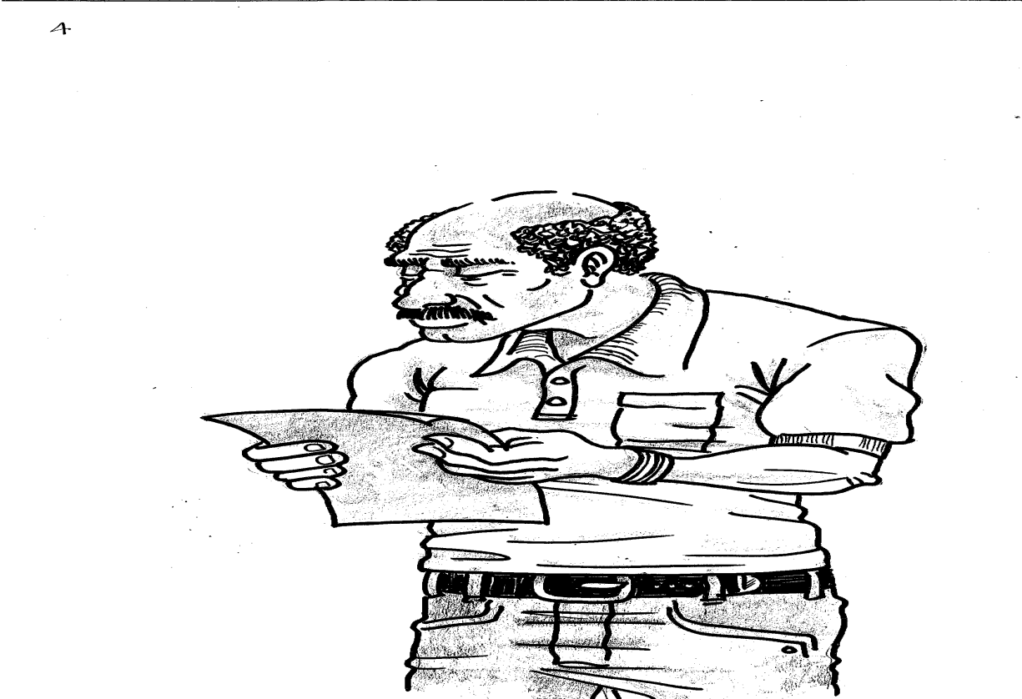
However, the school committee decided that they would organize some fundraising to build a new classroom. My grandpa was the treasurer. He looked after the money.

Slide 41
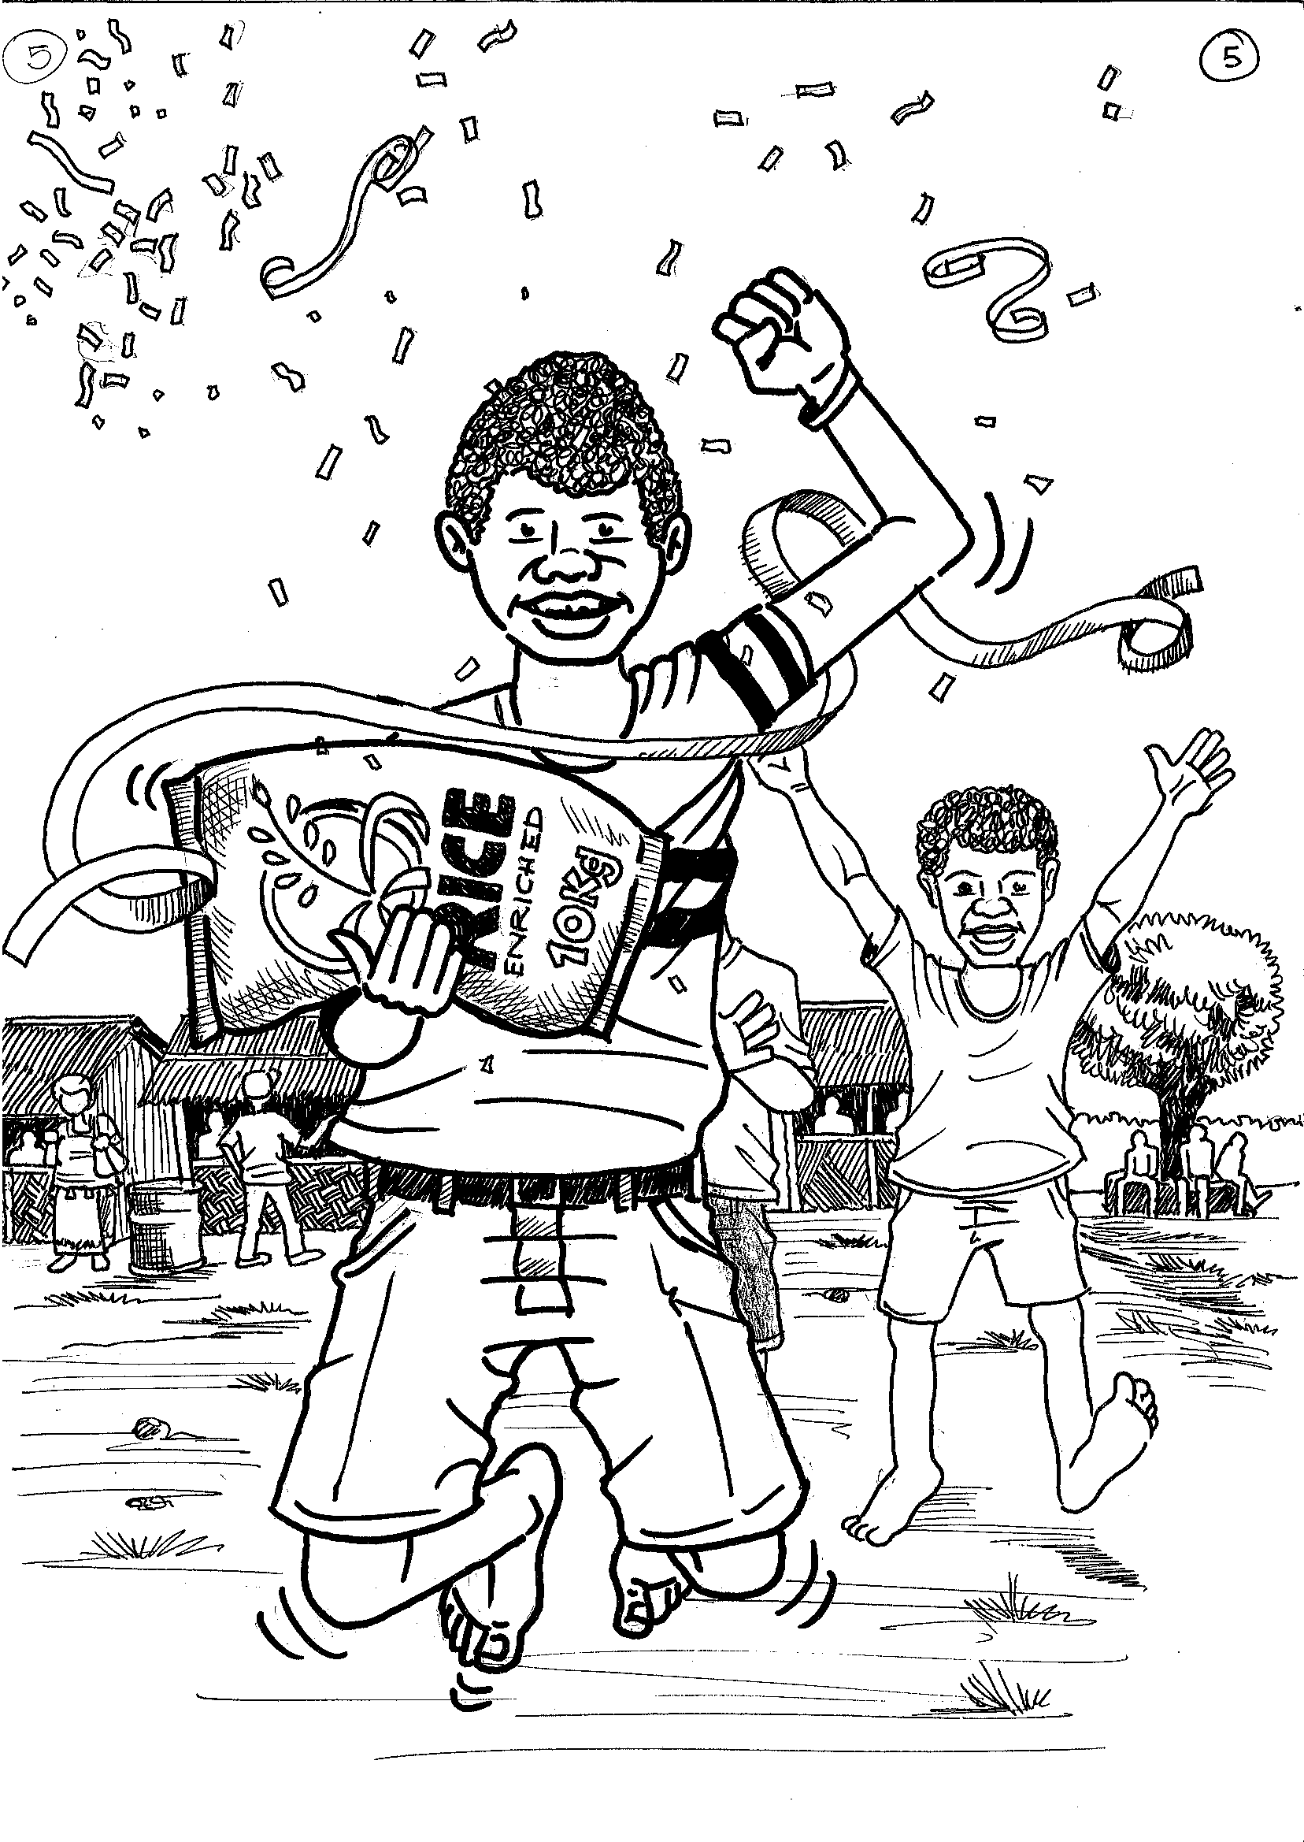
The school committee organized a school fair and sports day where everyone from the villages around the area came. It was really fun and I even won a prize of a 10 kg bag of rice.

Slide 42
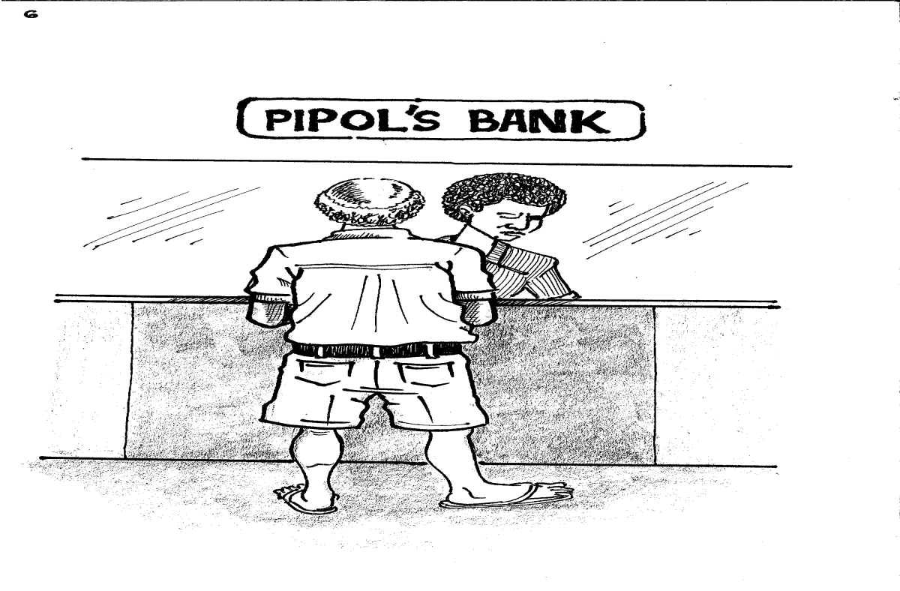
The school committee raised 36,542 kina and 70 toea. I think they were as surprised as anyone at how much they got. My grandpa took all the money and put it into the school bank account in town.

Slide 43
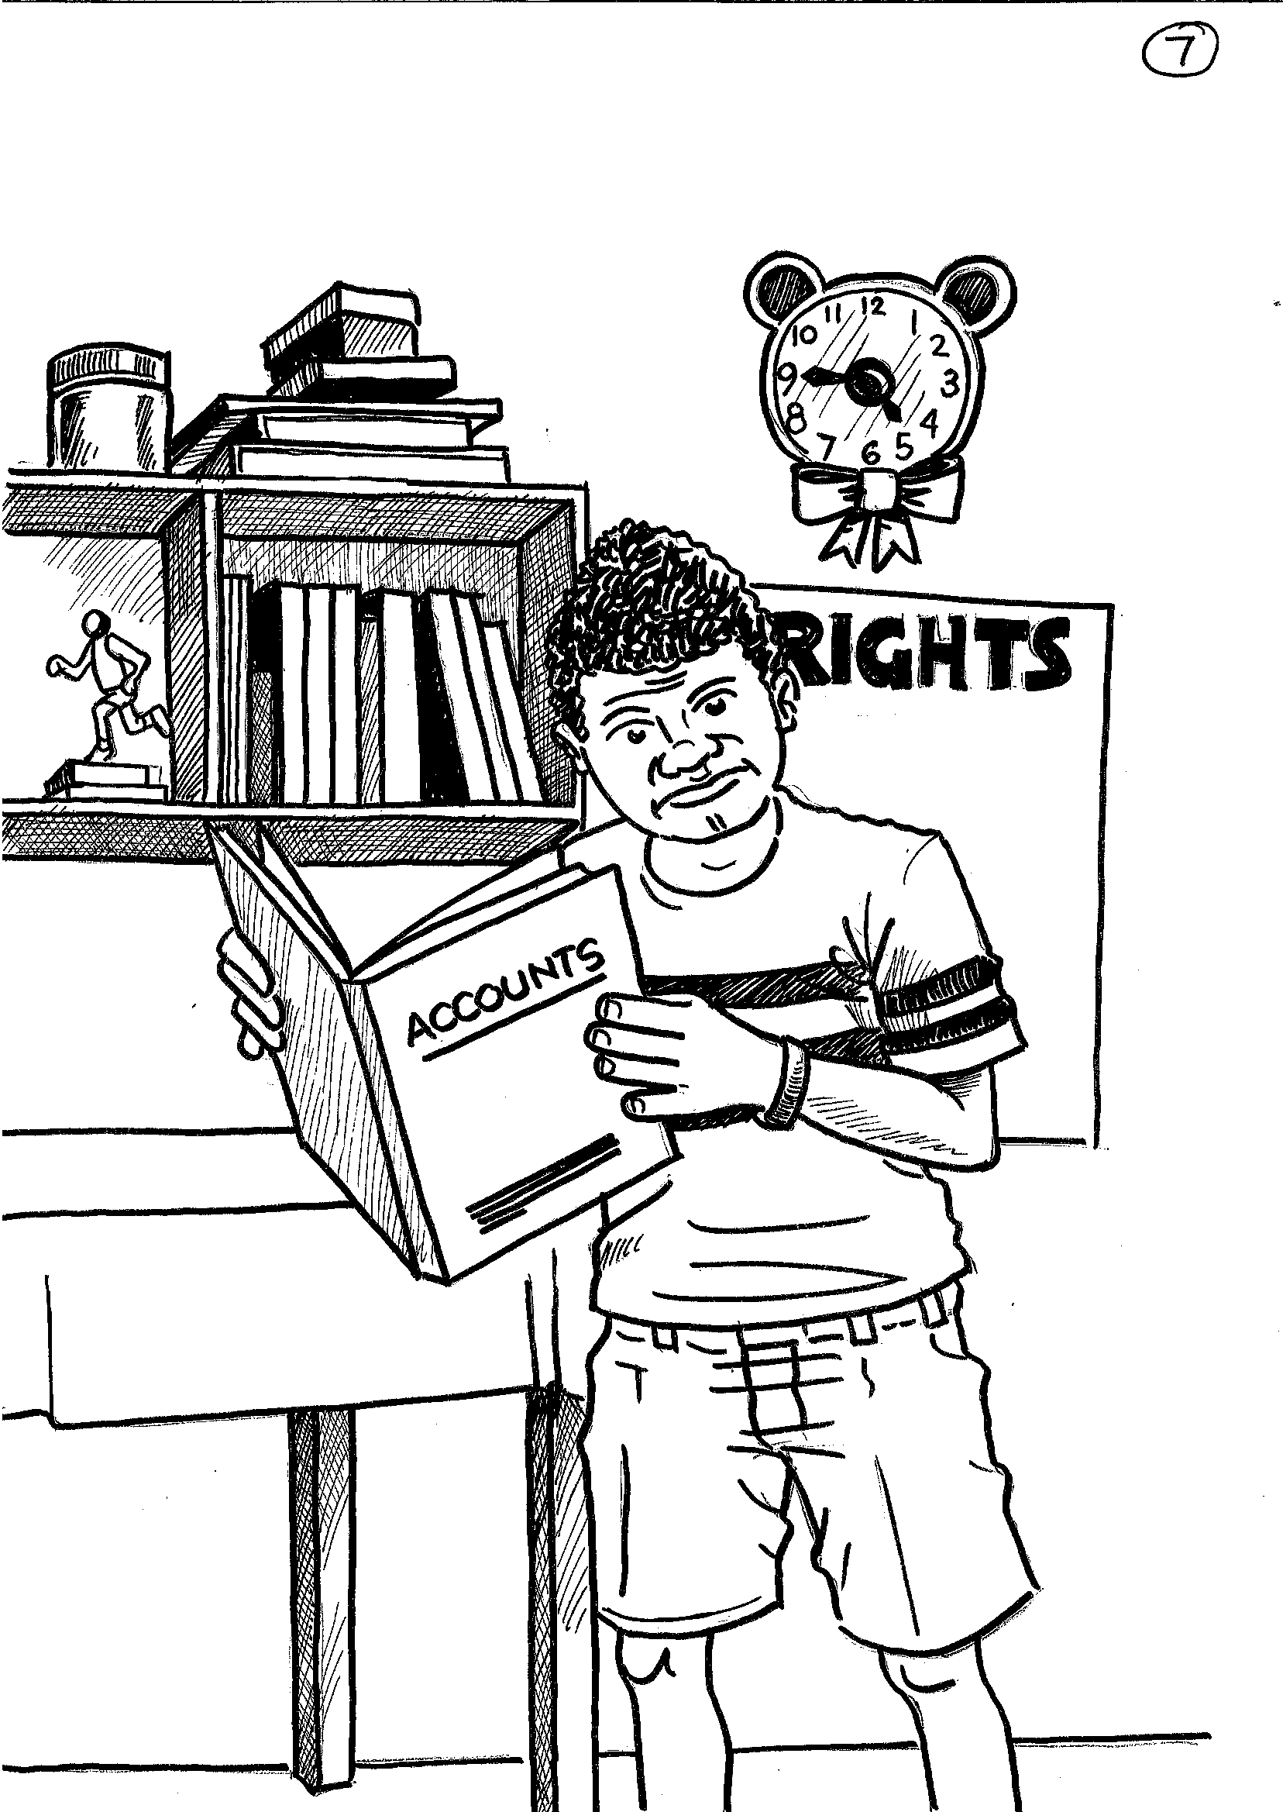
He stuck some papers from the bank in a blue exercise book, which had ACCOUNTS written in the front. I looked at it one day but it was very boring.

Slide 44
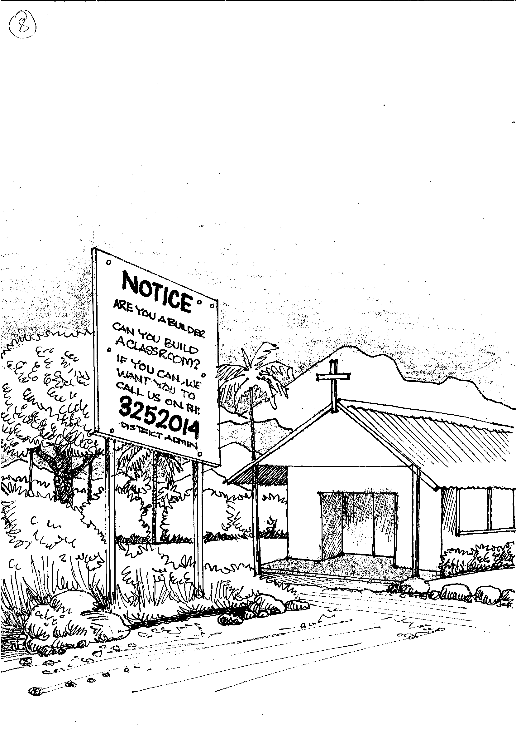
The school committee then put up a notice and made announcements in our church and in town. They said they were looking for builders to say how much they would charge to build a new classroom.

Slide 45
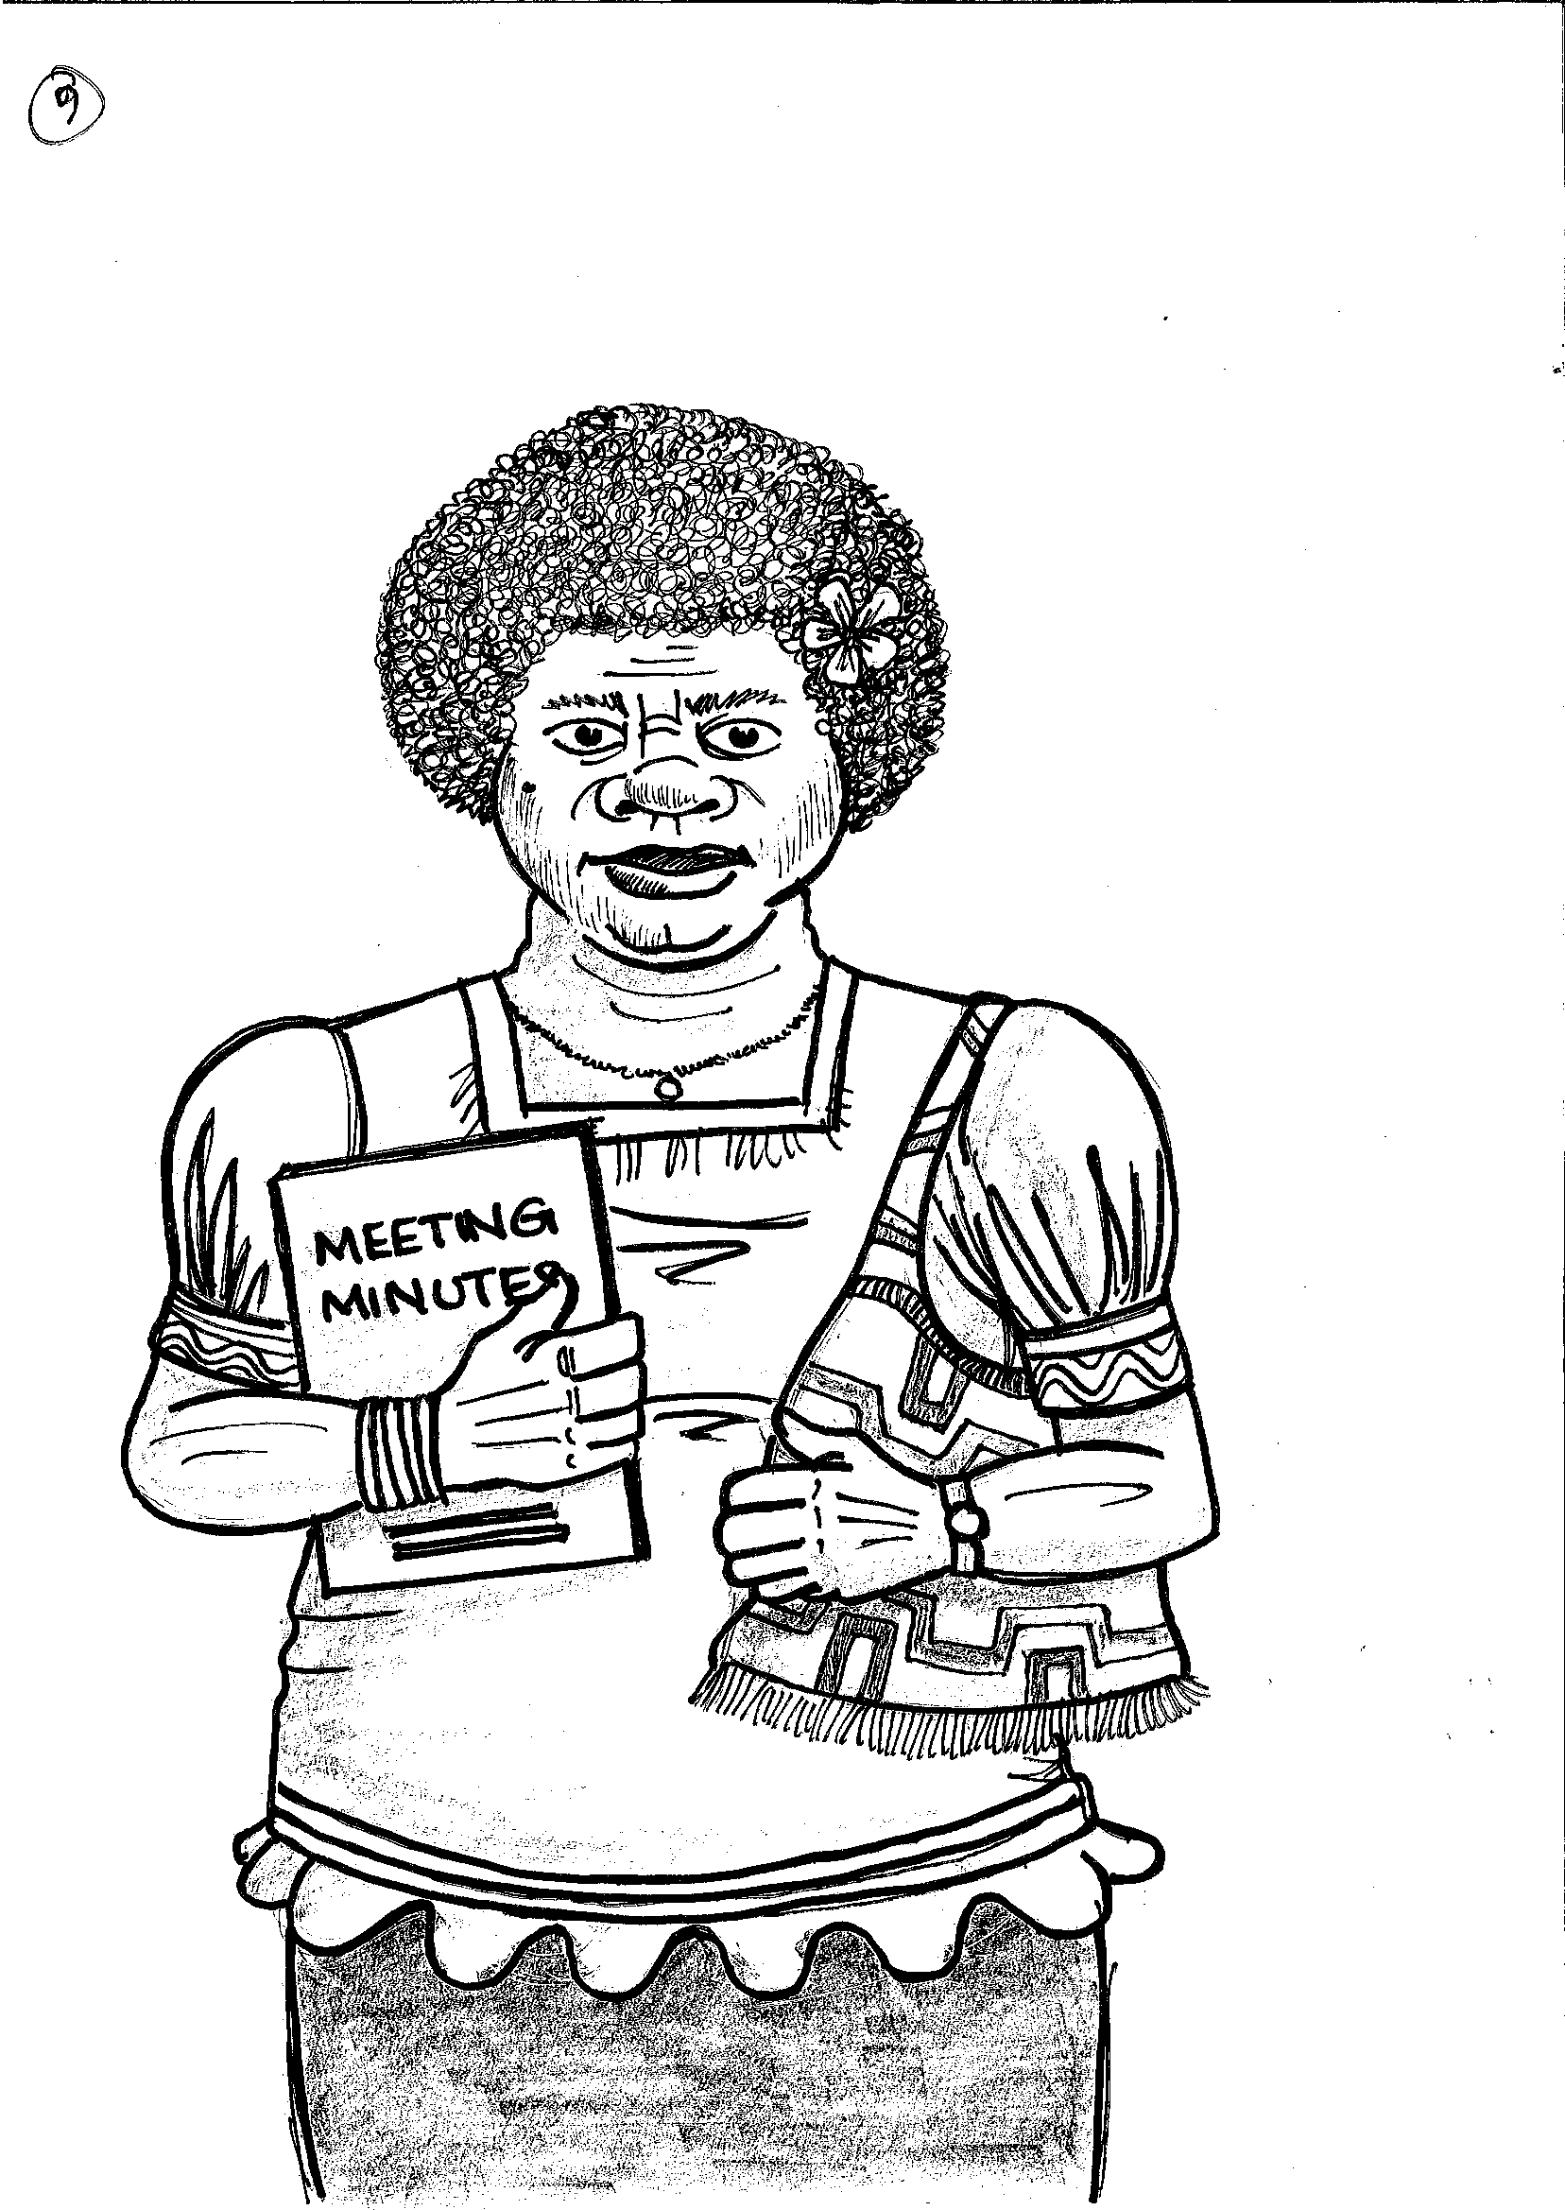
Everything that the school committee did was written in a red exercise book. The secretary was my best friend’s Aunty Melba.

Slide 46
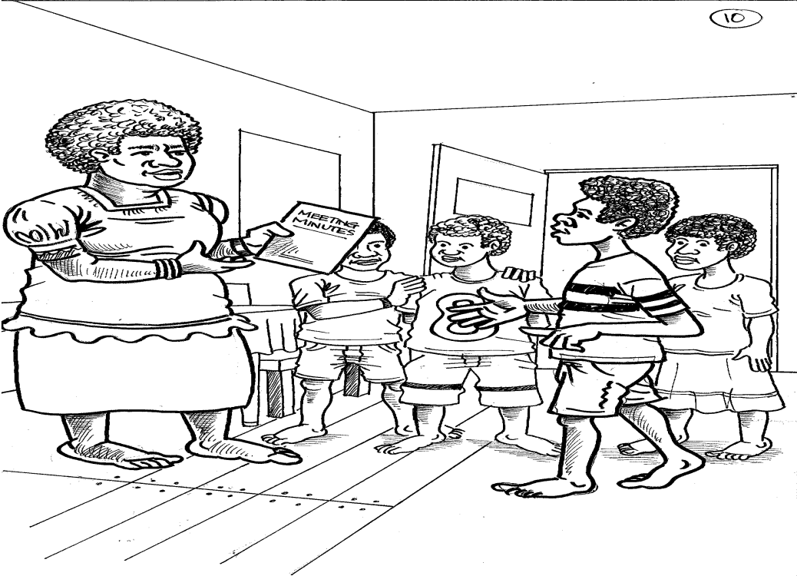
Aunty Melba used to keep the book at her house between meeting but no one ever asked to look at it. I was once at the house and I asked if my friends and I could look at the book. She said, “Yes, of course. You know anyone can come to those committee meetings but nobody ever does, except the committee.”

Slide 47
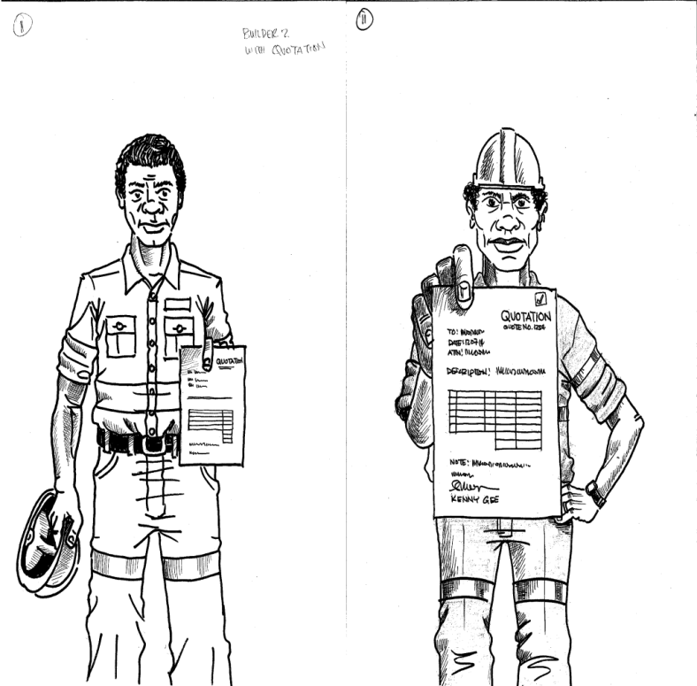
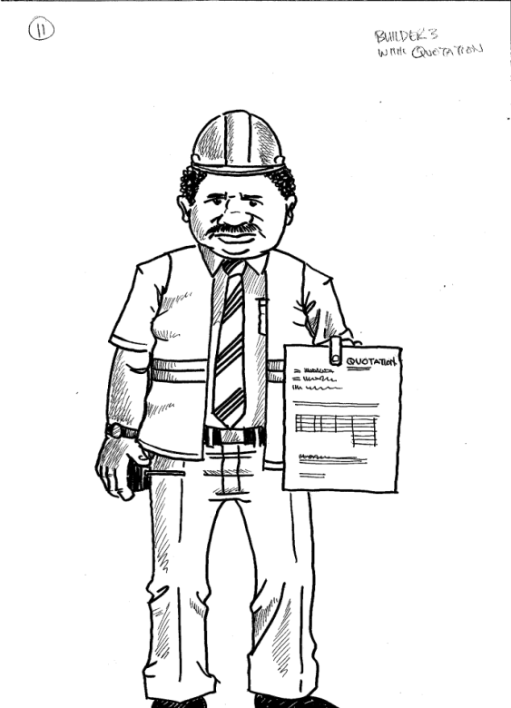
I read in the red book that the builders had to give the school committee their prices in a letter. Three builders had given their prices. They didn’t call them prices, they were called quotes. One of the builders was my cousin.

Slide 48
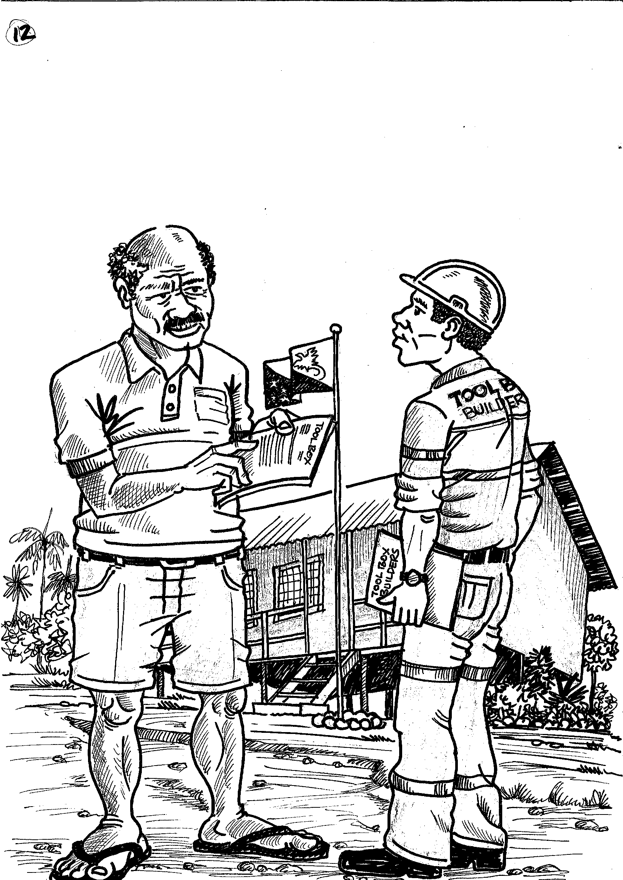
I read that in a meeting the week before, the school committee had not chosen my cousin. Instead they chose a builder from town and that my grandpa had to tell him.

Slide 49
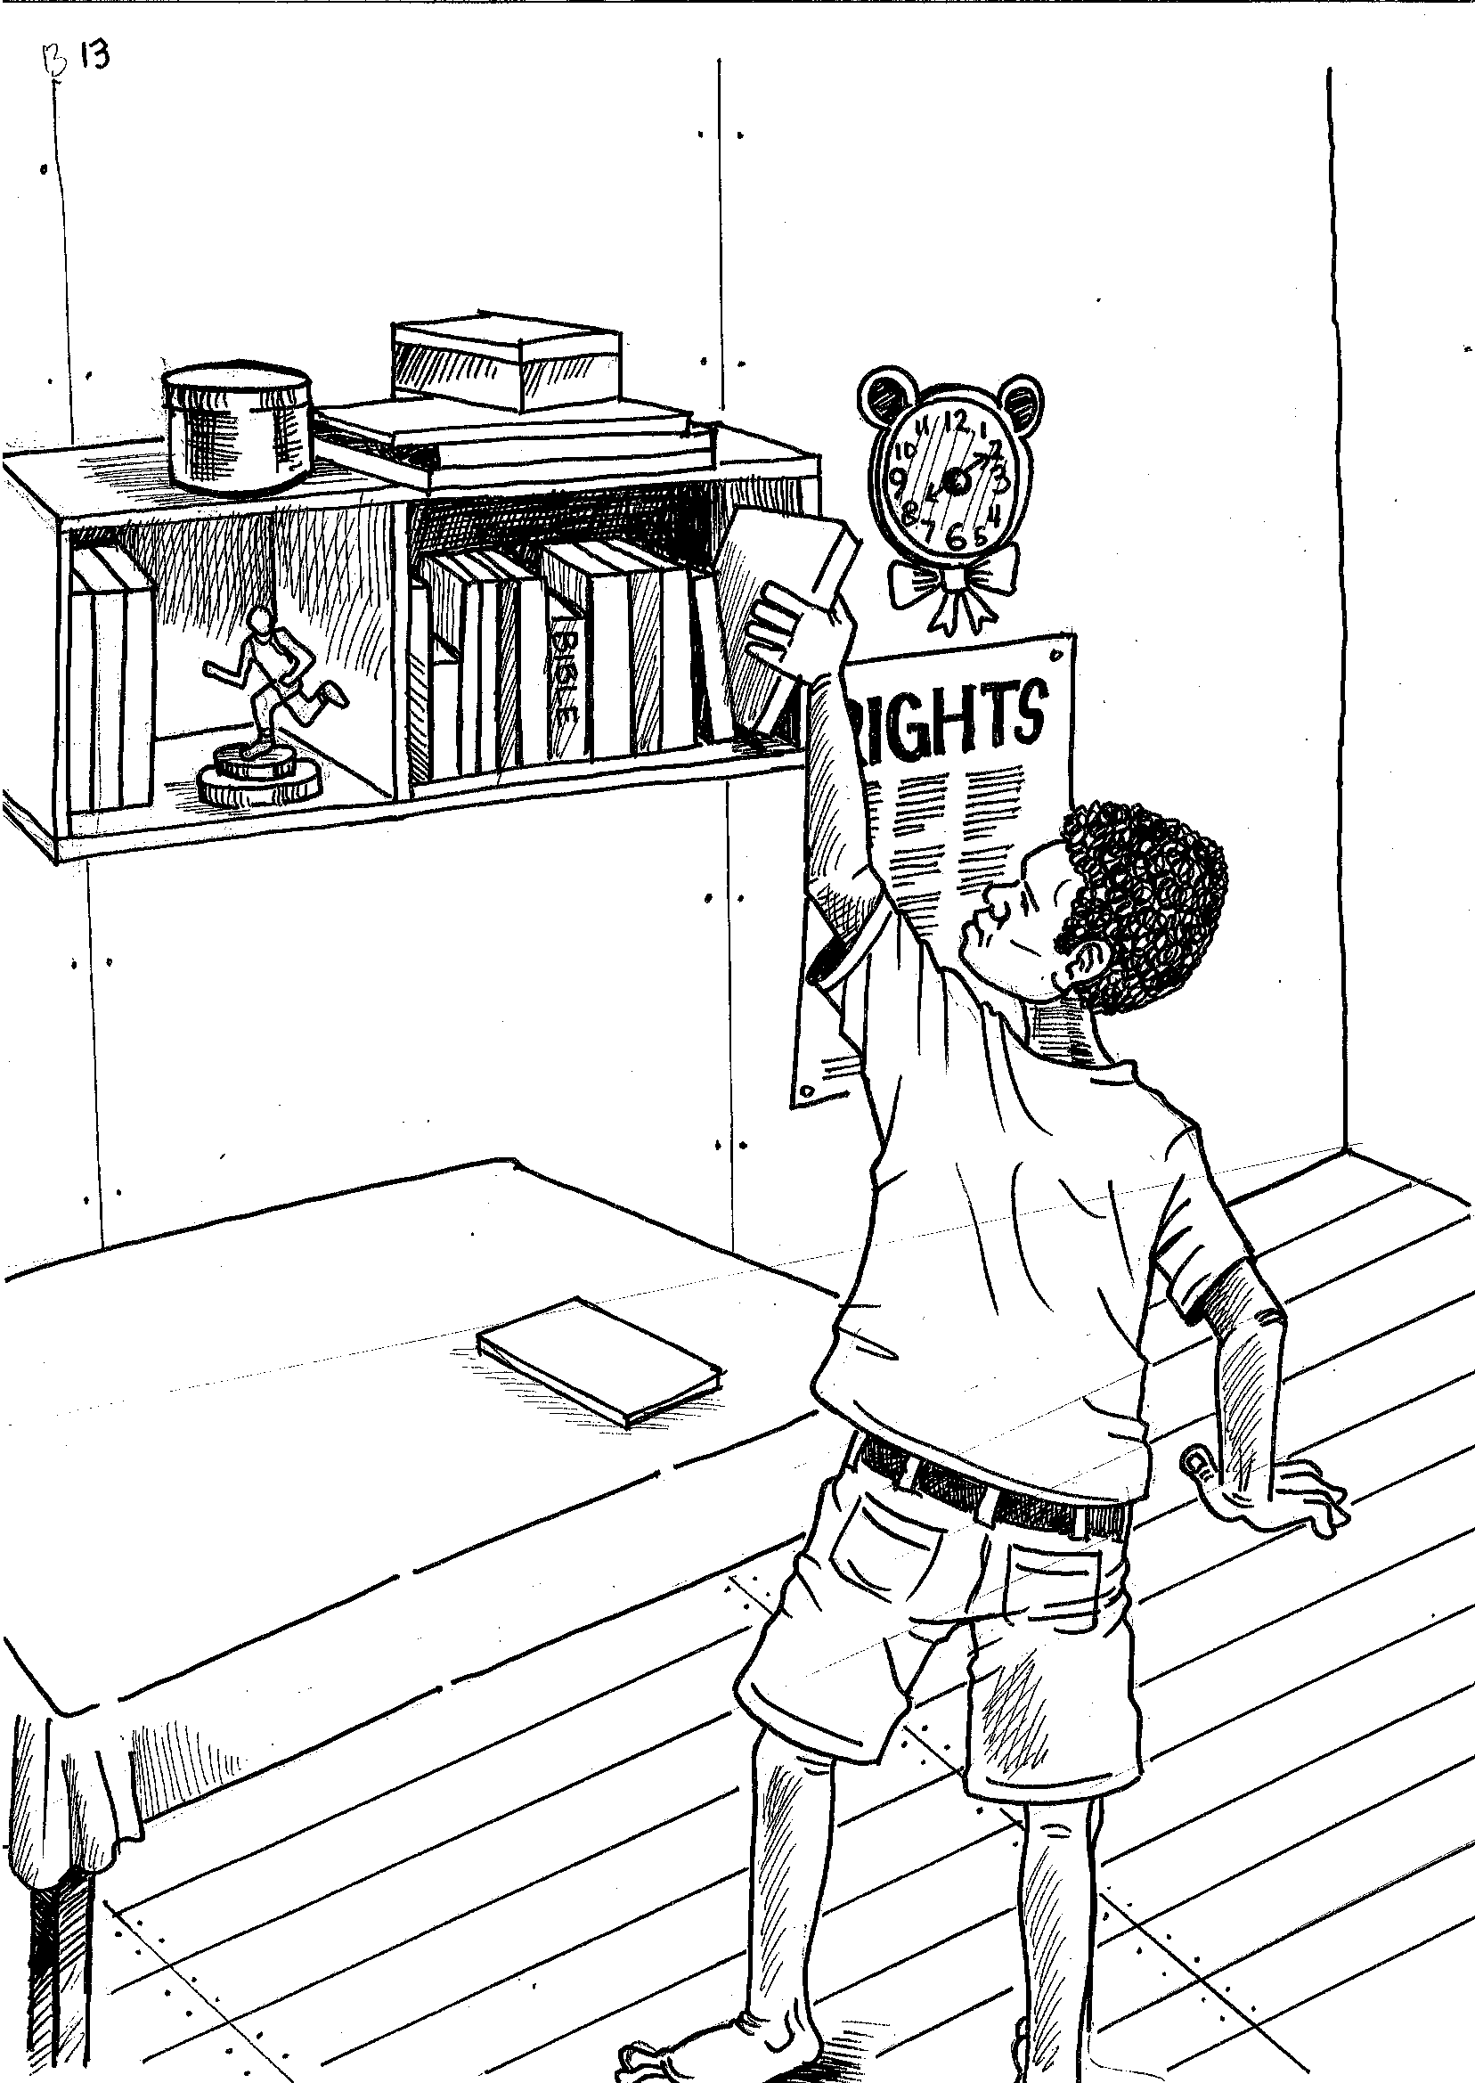
This was also a very boring book without any pictures or stories so I put it back on the shelf.

Slide 50
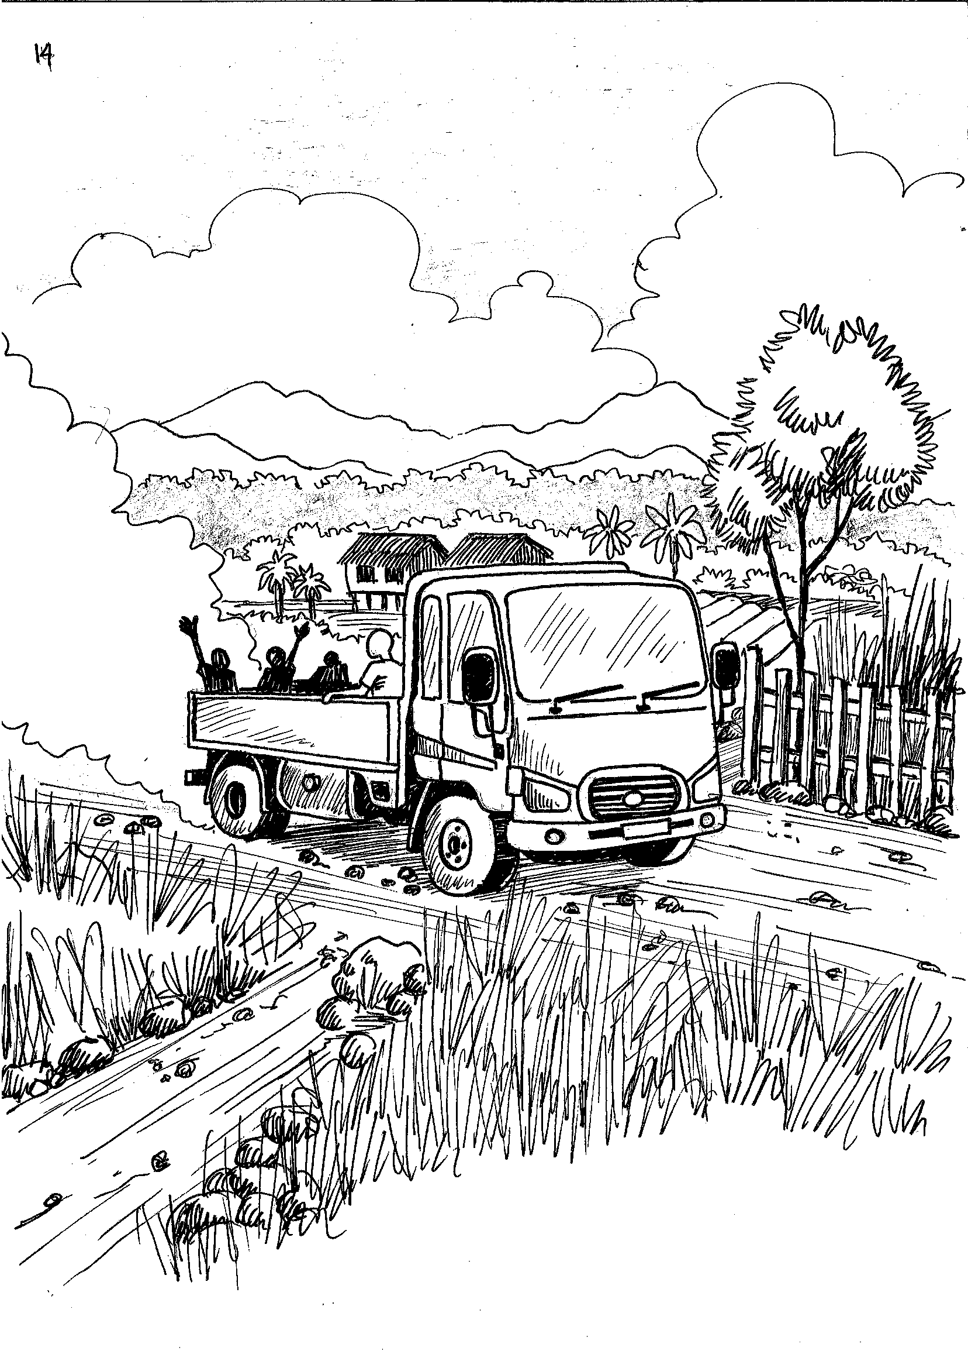
About this time, my grandpa bought a new truck with the money he had saved after selling his house in Port Moresby.

Slide 51
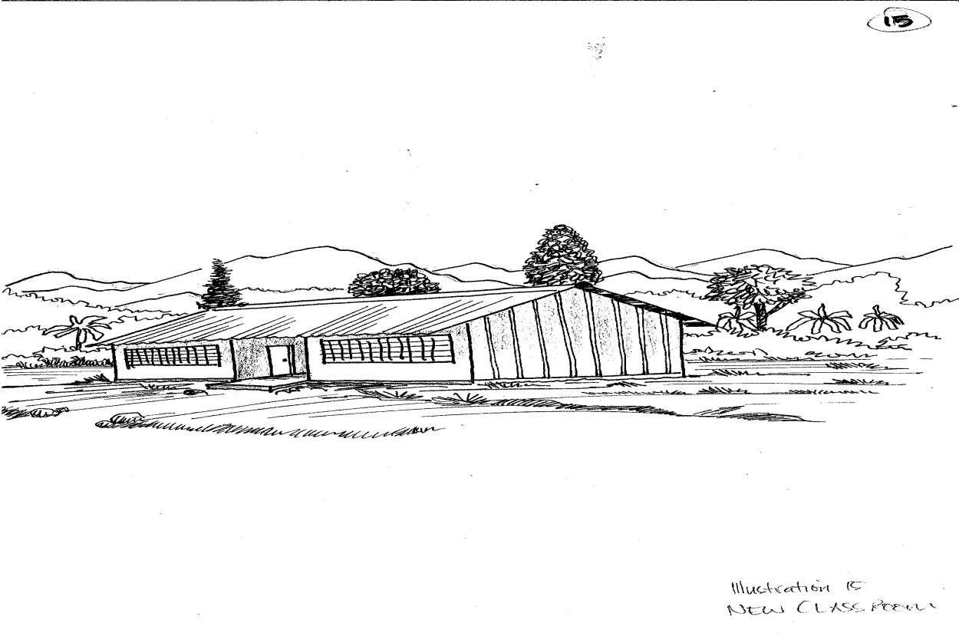
A week later the builder came and started building the new classroom. He got a few of the local youth to help and after six weeks it was finished.

Slide 52

My grandpa met with the builder at our house. The builder gave him all the papers which said how much he had paid for things.

Slide 53

Grandpa stuck them in his blue book. My grandpa tried explaining it all to me but I was looking out the window at the soccer game.

Slide 54

There was an opening ceremony and I saw my Grandpa write a cheque for the builder and give it to him. The next day my friend’s Aunt Melba went away on a trip to Port Moresby.

Slide 55

A few days later the school committee chairwoman came back in my grandpa’s truck. She had brought some new clothes for her kids and had a new mobile phone.

Slide 56

About now the stories began to go around. That my grandpa had used the money from the fair to buy the truck. That Aunt was in Port Moresby at the casino. That chairwoman had been using the money from the fair to buy new clothes. My grandpa just smiled when he heard this.

Slide 57

One day I heard someone say when he drove his truck past, “He stole the money… that’s really our truck.”
My grandpa just smiled when he heard this.

Slide 58

Another time someone in my class said to me that Aunt Melba was a no good woman!
My grandpa just smiled when he heard this.

Slide 59

There was another story that my grandpa had got some money back from the builder because he was chosen.
My grandpa just smiled when he heard this.

Slide 60

A few days later the school chairwoman came to our house in tears. My grandpa asked her to have a cup of tea and she went away feeling better

Slide 61

The time was coming up for the school committee elections. All kinds of stories began to go around. I heard a story that grandpa would use the money left from the fair to pay people to vote for him.
My grandpa just smiled when he heard this.

Slide 62

Finally, one of my friends said to me, “Hey is it true that your grandpa is going to get a helicopter?”
My grandpa burst out laughing when he heard this.

Slide 63

Two days later, there was a big meeting of all the people in our village in the church.

Slide 64

The chairwoman got up and said, “Ok everyone ,we have heard all kinds of funny stories about the money from the fair. It’s your money so now I am going to tell you. But before I start I want to ask all those people who made the stories why you never came to meetings? Why didn’t you ever come and ask to see the books when we write everything down?

Slide 65

Some called out, “Because I can’t read…. And anyway how do we know it’s true.”

Slide 66

Grandpa answered, “You should come with a friend and ask. But today is a good time for us all to learn a new word. Its TRANSPARENCY. It means that everything we do must be open for everyone to look at.” Grandpa wrote the word on a blackboard.

Slide 67

He then held up the red and blue books and said, “You know that if you go into the kitchen at night all the rats stealing your food will run away because they don’t want to be caught. If we were stealing the money we would not be showing you these books or asking you to come to the meetings.”

Slide 68

He then asked one of the biggest story makers to come up and check the book. Grandpa explained how much had been spent, how they chose the builder and how much was left over. Everyone was quiet.

Slide 69

Grandpa then held up a Milo tin and shook it and said, “Inside is the first 50 toea for my helicopter. Anyone want to donate some more?”

Slide 70

Everyone burst out laughing.

Slide 71
School based civic education
BIG BOOK ILLUSTRATIONS
THE PRIZE

Slide 72

My name is Robert and I am in Grade 8 at my school which is 10 kilometres from the town. There are two boys who are great sportsman in our district, Johnston Rokia and myself. Johnston went to school in town.

Slide 73

In our district we had a sports day that made me really angry. This is what happened.

Slide 74

That year we had a great prize for district sportsman of the year as well as the cup. The prize was the chance to fly from my island to a nearby island and back. I think one of the parents who works at the mine on the island had donated this prize.

Slide 75

I really wanted to win because I had always wanted to be a pilot and I had never been in a plane before.
To win we had to be leaders in our sports and do well on the district sports day in November.

Slide 76

Johnston was the captain of his school soccer team and I was the captain of our school team. During the year our team had won the district championship, and I had won the most improved player award in our school. Johnston’s team had come fourth.

Slide 77

So far as I was concerned, it all came down to the district sports day as we were still fairly close. Johnston beat me in the 400 metres and I beat him in the 800. I came fourth in the long jump for the district and Johnston sixth.

Slide 78

I managed to beat him in the high jump but actually neither of us were very good at that. We both played in our school volleyball teams. His team came fourth and ours sixth. I felt pretty sure that I was going to win the sportsman of the year award and that I would live my dream!

Slide 79

However, just before the end of the day, came the final race…. the 1600 metres. I wasn’t too worried as I felt that I was better over long distances than Johnston. However, I knew this race was going to be important and everyone would be watching.

Slide 80

As we lined up all the people were yelling encouragement to us. The start sounded and off we went. Johnston was in front of me in third place until the third lap of the 400 metres course. I then sped up and over took him. The crowd didn’t seem to notice much as I was still only in third place still.

Slide 81

I slowly caught up to the second place runner and then passed him with about 250 metres to go. The crowd now started to yell. I could hear them yelling Johnston’s name too which surprised me as I thought he was in fourth place.

Slide 82

I drew level with the first place runner, Peter about 90 metres away from the line and started to pass him. Suddenly, I saw Johnston come from behind me and try to pass.

Slide 83

I found an extra bit of energy and went as fast as I could. I got back in the lead but there was only 60 metres left.

Slide 84

Johnston then pushed hard and again started to pass when suddenly he tripped and nearly fell about 30 metres way from the line. While this happened Peter came alongside me.

Slide 85

We broke through the line, and Johnston came third or fourth. We were both exhausted, but we shook hands with all the people who ran. I said to Johnston, “Man you nearly got me!” and he smiled.

Slide 86

The only way the judges could tell who won was to look at a photo one of them took on his mobile phone. I had come second by a fingernail! Johnston had come fourth. Still I was happy…. I had clearly beaten Johnston.

Slide 87

While we were getting drinks and going back to our school areas the judges were making their decisions. Some of our teachers were on the judging panel.

Slide 88

We were all sitting when the announcement was made. Johnston had won the sports man of the year award for the district. At first I was silent and then I got angry. On the way back to our school my teacher, who I really respected, asked me if I was ok.

Slide 89

I angrily replied, “What happened? Why didn’t I win? Is it because I am part highlander or something stupid like that!”

Slide 90

“No, that had nothing to do with it. But you know who Johnston’s uncle is…. don’t you?” she answered.
“Yeah. He is the chairman of the district sports committee. He is big in the district politics. But what has that got to do with it?” I replied.

Slide 91

“That’s correct.” said my teacher. I was silent and looked out the window of the bus. I then said, “But that’s got nothing to do with it. It was supposed to be about who was the best sportsman, not who you are related to!”

Slide 92

My teacher put his arm around me and said, “So what next?” I said, “No more playing sports for me!” My teacher smiled and said, “Oh good, so now you will get your homework done on time!”

Slide 93

That was a few years ago. I did stop playing seriously for three years. Johnston and I went on to high school, but no one from our district ever made it into the provincial team.
I did play seriously at Tech and I am now playing for the national team. Whenever, any wantoks ask me if I can help them get on the team I always say, “How fast are you at the 1600 metres?”

